Slide 1
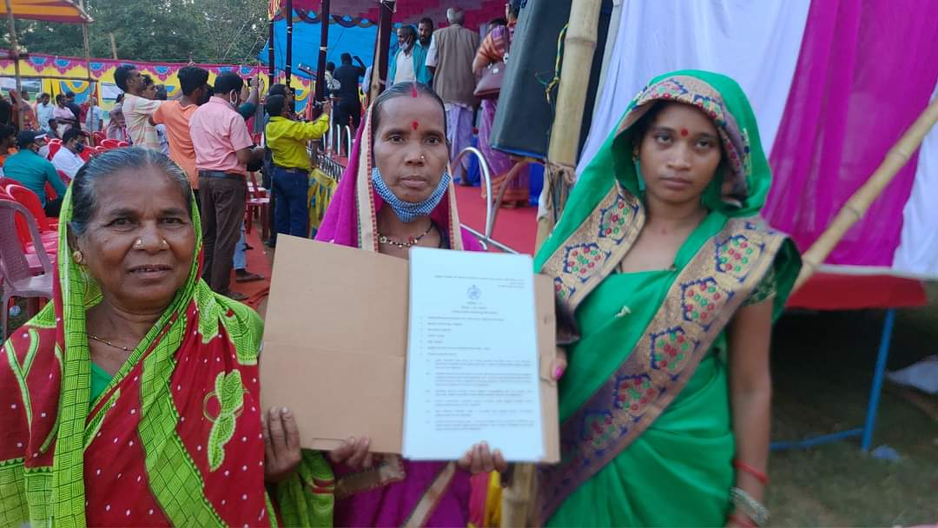

Training on Typology of Forest Rights
District Level Training under Mo Jungle Jami Yojna, Kandhamal
Date: 29.11.2023
Ranjita Pattanaik
Prog. Officer, Vasundhara

Slide 2
Typology of Forest Rights
Forest Rights
Individual Forest Rights
Community Rights
Right over Community Forest Resources
Developmental Rights
Right over Habitat
Right over Seasonal Landscape
Conversion of Forest Villages into Revenue village

Slide 3
Nature and Extent of Individual Forest Rights
Individual Forest Rights
Self-Cultivation
In or over Disputed Land
In situ or alternative land
Actual Occupation or Max. 4 hects.
Actual Occupied Area
Actual Occupation or equivalent area
Conversion of Pattas or Leases
Actual Area mentioned
Self-Cultivation includes forest land used for allied activities ancillary to cultivation, such as, for keeping cattle, for winnowing and other post-harvest activities, rotational fallows, tree crops and storage of produce [12.A.(8)]

Slide 4
“Community Rights” means the rights listed in clauses (b), (c), (d), (e), (h), (i), (j), (k) and (l) of sub-section (1) of section 3.
Nature and Extent of Community Forest Rights
Community Rights
Nistari including those used in erstwhile princely States
Right of ownership, access to collect, use and dispose of MFP
Right of uses or entitlements such as fish & other products of water bodies, grazing
Traditional Seasonal Resource Access of Nomads or Pastoralist Communities
As Defined in the Nistari Patra or any other document
Within and Outside the village boundary
Traditionally use Area
Seasonal Access Area

Slide 5
Nature and Extent of Forest Rights
Community Rights
Customary Boundary of such Community
Right of Settlement and Conversion of Forest villages, unsurveyed villages, etc.
Right to protect, regenerate or conserve or manage any Community Forest Resource
Rights accepted as rights of tribals under any traditional or customary law
Access to Biodiversity and community right to IP & TK related to Biodiversity & Cultural Diversity
Community Tenures of Habitat and Habitation for PVTGs & Pre-agricultural communities
Actual Land-use of the village in its entirety including land required for current & future community uses
Customary Common Forest Land within the traditional or customary boundary of the village
As defined in the Traditional or Customary Law of such tribe

Slide 6
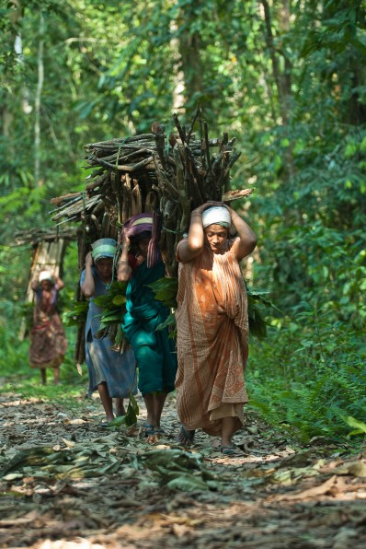
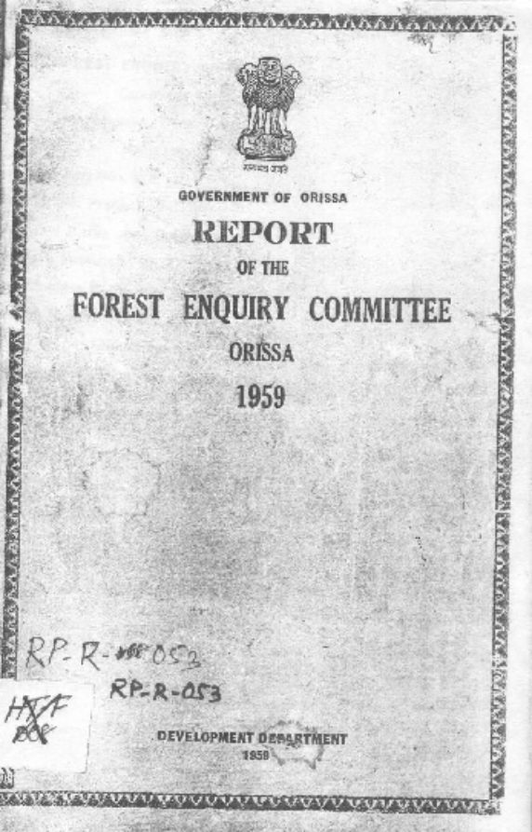
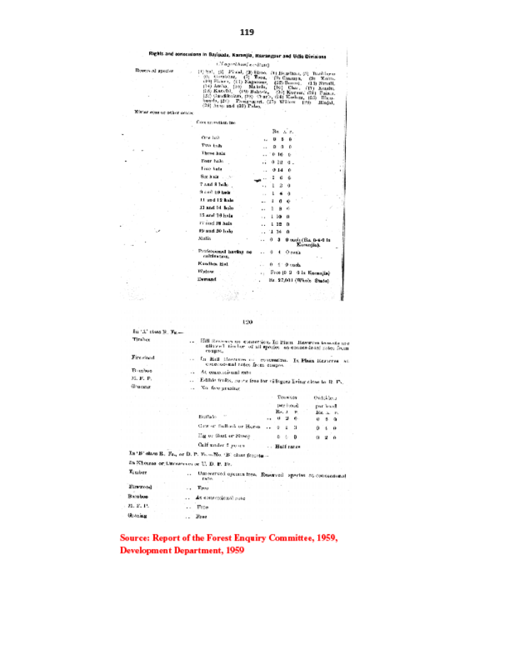
Nistar rights those which were recognized earlier such as fuelwood, timber for household and agricultural purposes (Section 3-1-(b))

Slide 7
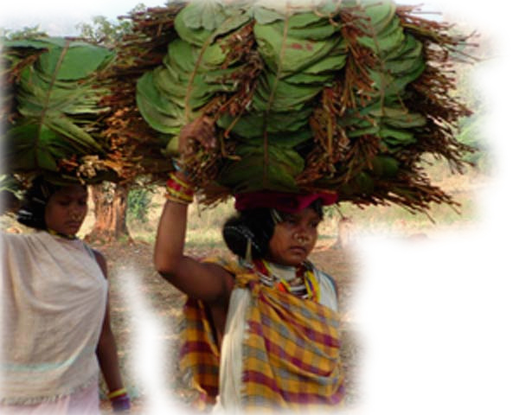
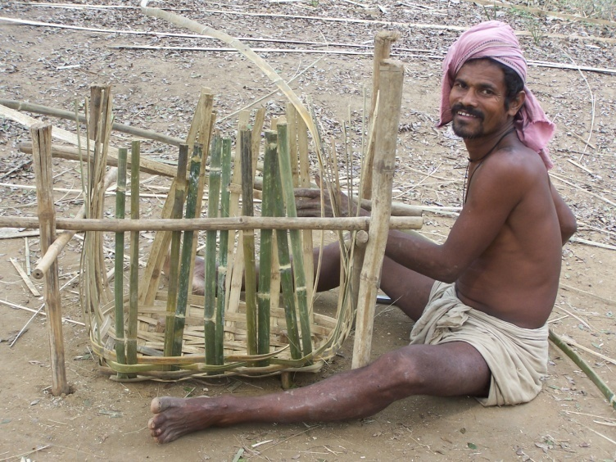
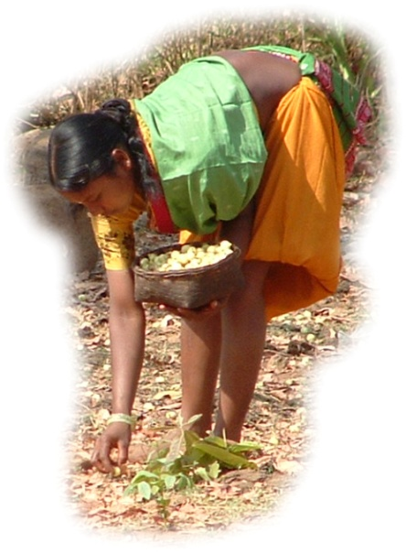
Right of ownership, access to collect, use and dispose (Sec 3 (1)(c))
-MFP means all non-timber forest produce of plant origin, including bamboo, brush wood, stumps, cane, tussar, cocoons, honey, wax, lac, tendu or kendu leaves, medicinal plants and herbs, roots, tubers and the likeKL and Bamboo
-Transportation of MFP through appropriate means
-Transit permit to be issued by committee constituted under rule 4 (1)(e) or person authorized by Gram Sabha
-Collection of MFP shall be free of all royalties

Slide 8

Use of Water bodies and fishing (Section 3 (1)(d))

Slide 9
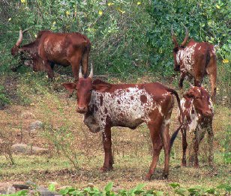
Grazing rights
(Section 3 (1)(d))

Slide 10
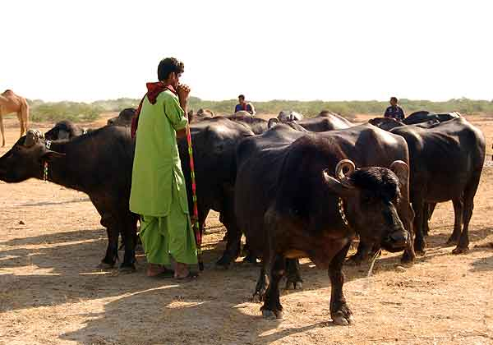
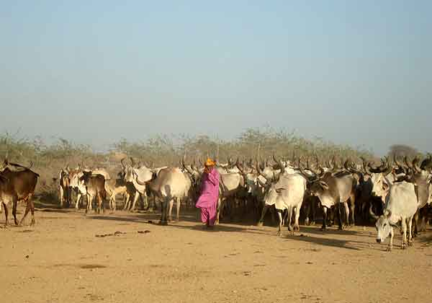
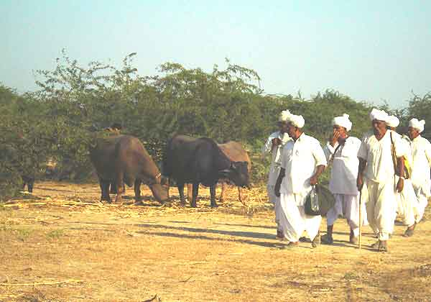
Rights of pastoralist communities (Section 3 (1)(d))
Maldharis of Banni, Gujarat
Photo-Sahjeevan

Slide 11

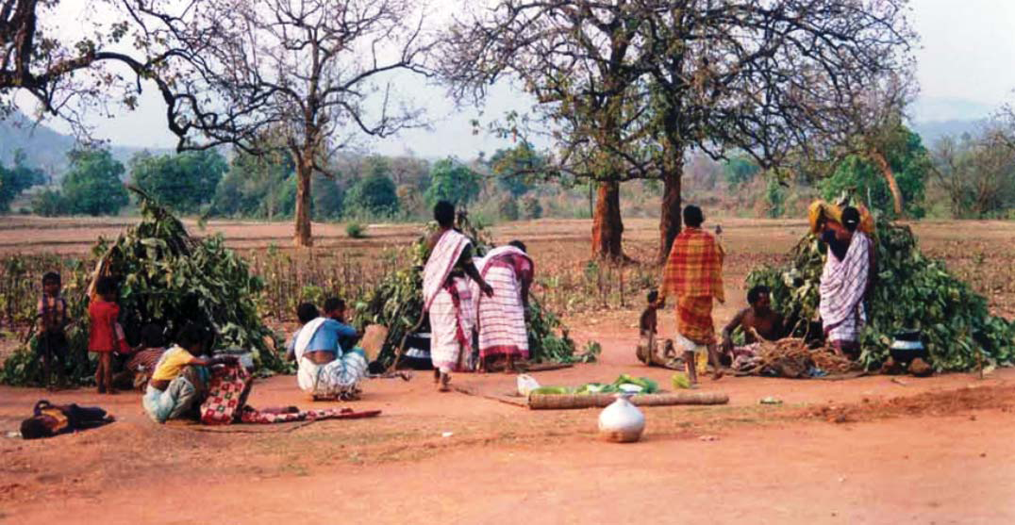
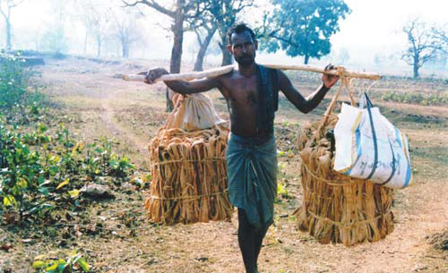
Traditional resource access of nomadic tribes
(Sec (3)(d))
Source: SCSTRTI booklet on Mankirdia

Slide 12
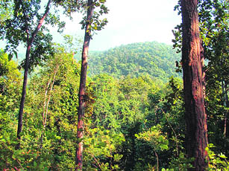
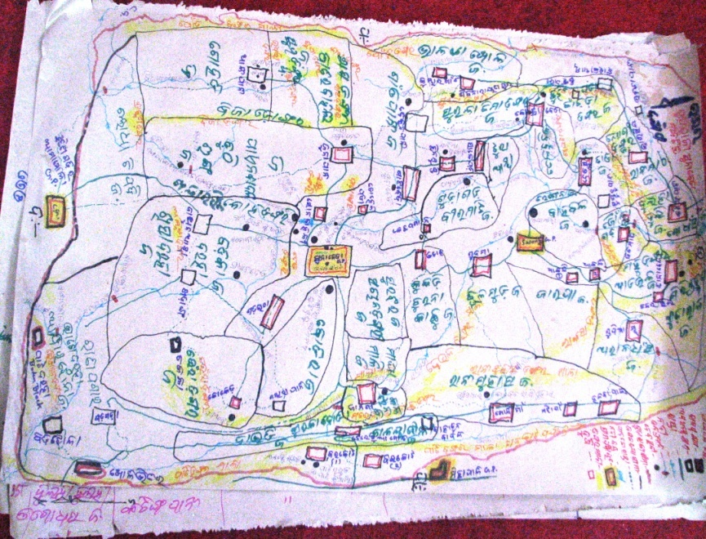
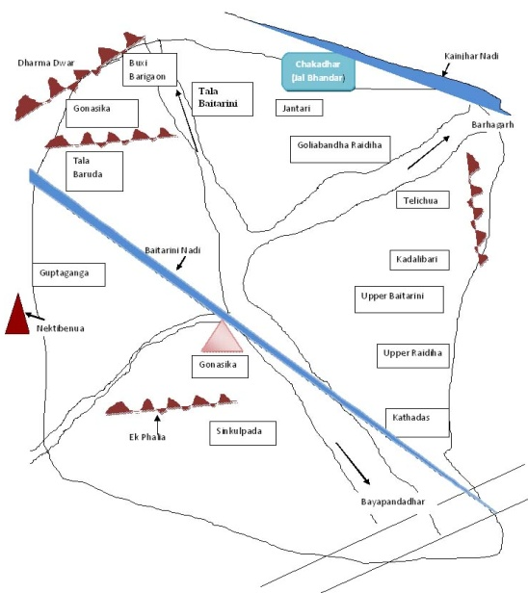
Habitat Rights of PVTGs
(Section 3 (1)(e))
Niyamgiri-Sacred hill of Dongrias
Guda Raija-Habitat rights of Chuktia-Bhunjia
Pirha of Juangs

Slide 13
Settlement and conversion of forest and unsurveyed villages into revenue villages-Section 3 (1)(h)
Identification of forest villages, un-surveyed villages, old habitations
Formalization (notification) of the forest and un-surveyed villages
Conversion of forest un-surveyed villages into revenue villages and recognition of rights
MOTA issued guidelines on 08/11/2013 for the conversion of forest villages into revenue villages &

Slide 14
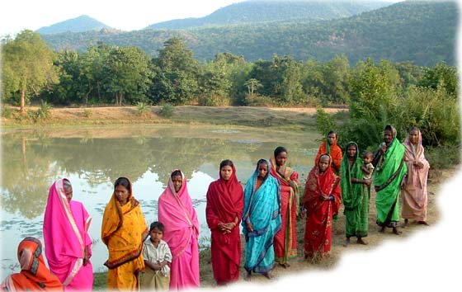
Rights to community forest resource-section 3 (1)(i)
Management rights
Forest protection groups in Nayagarh

Slide 15
Rights which are recognized under any State law....or which are accepted as rights of tribals under any traditional or customary law of the concerned tribes of any State (Sec 3 (1)(j));
Example
  Customary rights recognized under Chottanagpur Tenancy Act (CNTA) and Santhal Pargana Tenancy Act (SPTA) in Jharkhand
  Customary land ownership and rights recognized under state laws

Slide 16
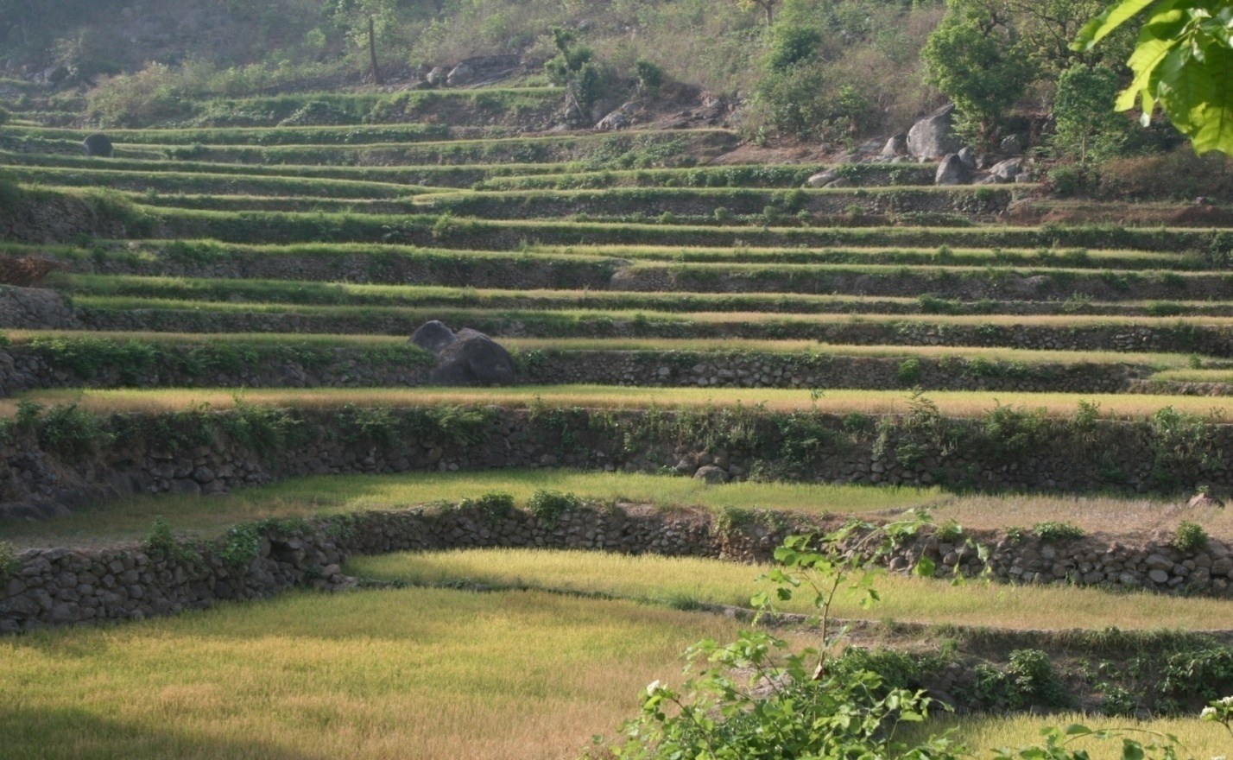
Access to biodiversity, community rights over intellectual property and traditional knowledge
(Sec 3 (1)(k))
-Access to biodiversity
-Medicinal plants
-Cultural diversity
TERRACE CULTIVATION & Agro-Biodiversity Landscape OF LANJIA SAORA

Slide 17
Other traditional rights
(Section 3 (1)(l))
Any other traditional right customarily enjoyed by forest-dwelling scheduled tribes and other traditional forest dwellers, such as,
  Sacred groves, places of worship (Jahira, Mayurbhanj, Keonjhar)
  Right to passage etc
…but excluding traditional right of hunting or trapping or extracting a part of the body of any species of wild animal

Slide 18
Developmental Facilities
Section 3(2)
Nature and Extent of Forest Rights
Developmental Rights
Dispensary or Hospital
Anganwadi Centres
Fair Price Shop
Electric and Telecommunication
Schools
Tanks and other minor water bodies
Drinking Water Supply
Developmental Rights
Vocational Training Centres
Non- Conventional source of Energy
Roads
Community Centres
Minor Irrigation Canals
Water harvesting Structures
Maximum 1 Hectare in each Case or Felling of trees not exceeding 75 trees per Hectare;
Doesn't Require Approval under FCA, 1980;
Only State, Central Govt departments and ZP can be the project proponent

Slide 19
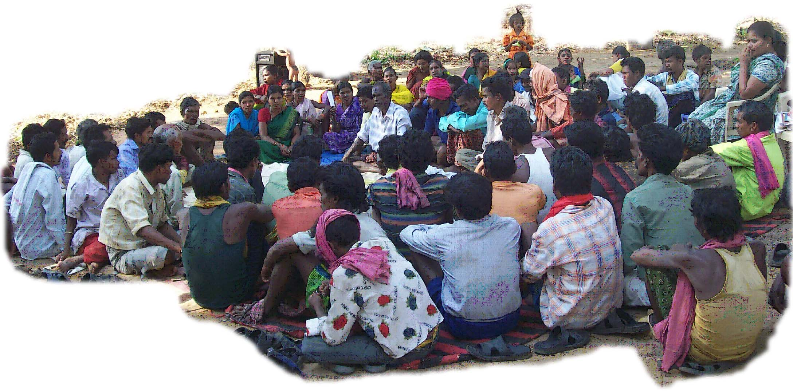
THANKS

