Slide 1
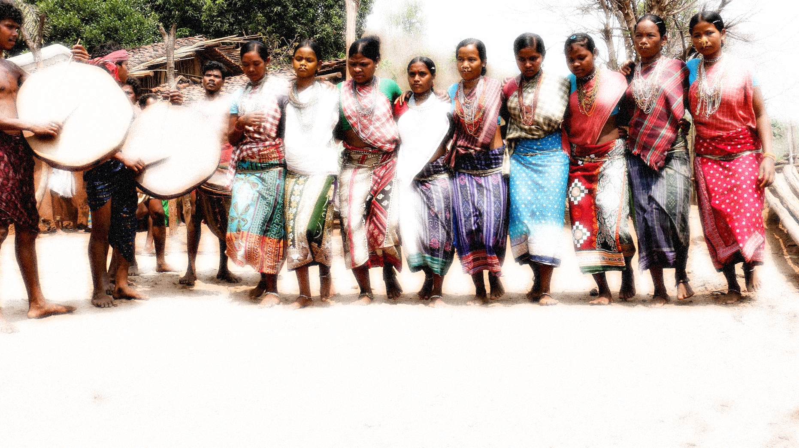

Recognition of Habitat Rights under Forest Rights Act 2006
Aurobindo Rout
VASUNDHARA
30 November 2023
ITDA Conference Hall, Phulbani

Slide 2
Origin of the Concept
The Dhebar Commission (1960-1961) stated that within Scheduled Tribes there existed an inequality in the rate of development.
During the fourth Five Year Plan a sub-category was created within Scheduled Tribes to identify groups that considered to be at a lower level of development. (1969-74)
In 2006 the government of India proposed to rename "Primitive tribal group" as “Particularly Vulnerable Tribal Group"

Slide 3
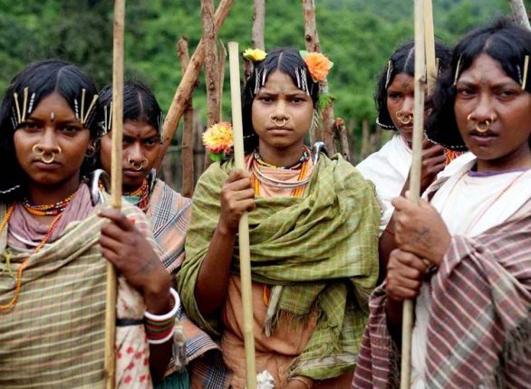
PVTGs how Different from other Tribes
Primitive
Geographically isolated
Shy and socially backward
A pre-agriculture level of technology
A stagnant or declining population
Extremely low literacy
A subsistence level of economy

Slide 4
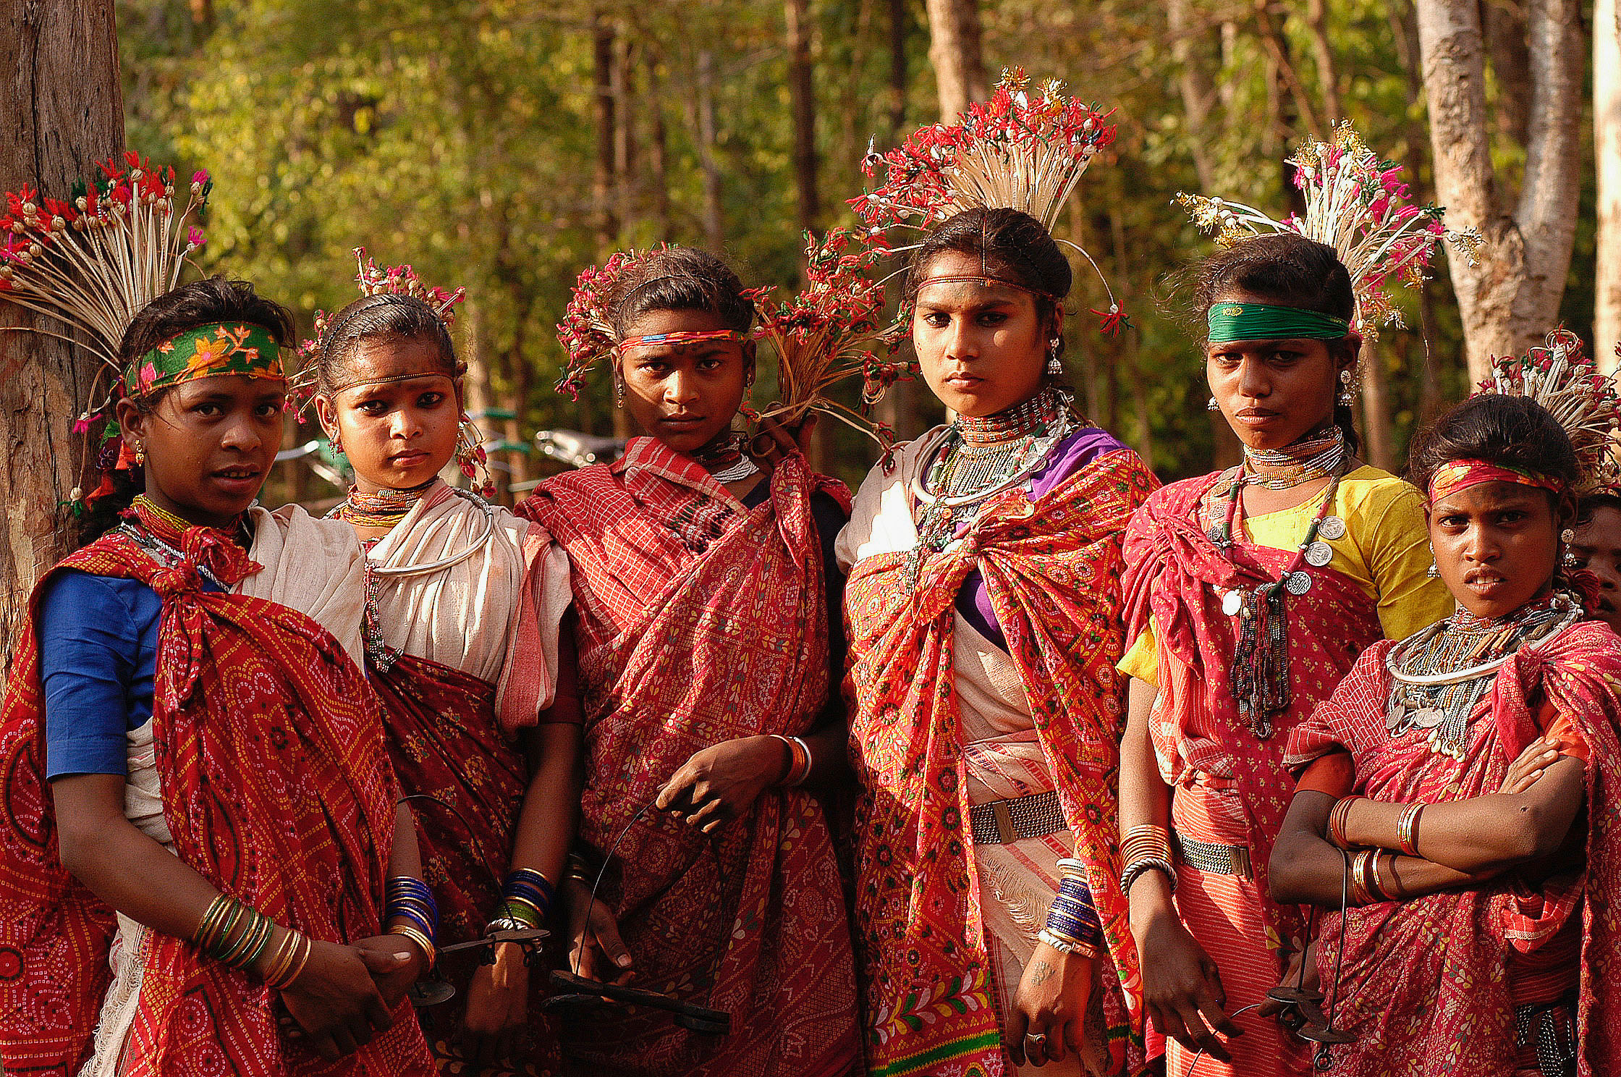
Particularly Vulnerable Tribal Groups (PVTG)
There are 75 PVTGs in the country
Odisha (13),
Andhra Pradesh (12)
Bihar including Jharkhand (9)
Madhya Pradesh including Chhattisgarh (7)
Tamil Nadu (6)
Kerala and Gujarat having five groups each.
West Bengal (3)
Maharashtra (3)
two each in Karnataka and Uttarakhand
one each in Rajasthan, Tripura and Manipur.

Slide 5
PVTGs in Odisha (13)
Bonda & Didayi- Malkangiri
Juang- Keonjhar
Hill Khardia & Mankidia- Jashipur
Lodha- Morada (Mayurbhanj)
Lanjia Soura- Gajapati & Gunupur
Chuktia Bhunjia- Nuapada
Paudi Bhuyan- Angul and Sundargarh
Saura- Gajapati & Ganjam
Dangaria Kondh- Rayagada
Kutia Kondh- Kandhamal & Kalahandi
Birhor- Kalahandi, Sundergarh, Mayurbhanj

Slide 6
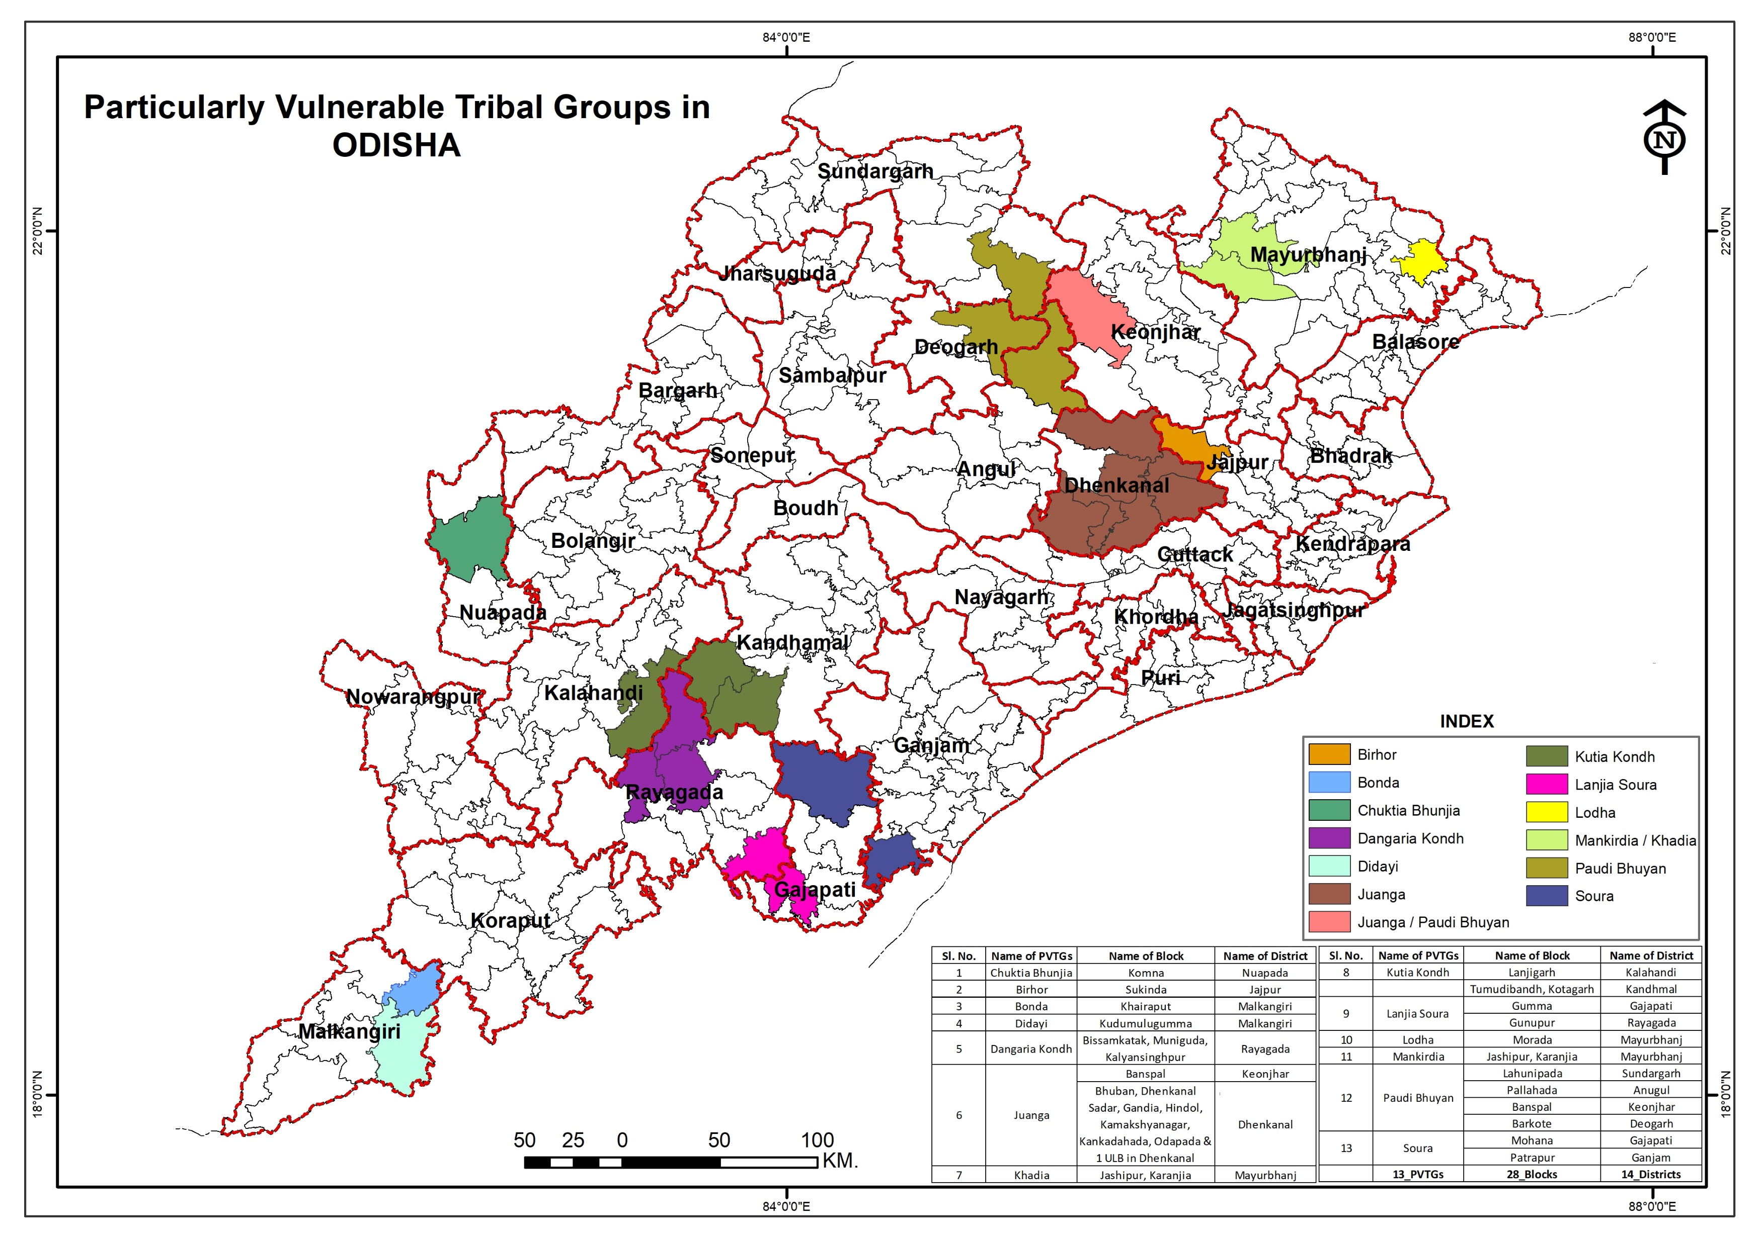

Slide 7
Nature and Extent of Habitat Rights
1
Right to perform all customary religious or cultural ceremonies in the landscape related to their clans.
2
Right to protect and conserve the natural entities and sacred sites located within and outside of their customary territories;
3
Right to protect and conserve the places important for religious and spiritual purposes.
4
Right to reside in and around the forest according to their customary and traditional practices.
5
Right to practice traditional cultivation systems and other livelihood generating activities including seasonal resource use.
6
Right to organise customary social events.

Slide 8
Provisions under Forest Rights Act 2006
Section 2(h) of the Act: (in definition part)
“Habitat” includes the area comprising the customary habitat and such other habitats in reserved forests and protected forests primitive tribal groups and pre-agricultural communities and other forest dwelling Scheduled Tribes.

Slide 9
Provisions under Forest Rights Act 2006
Section 3 (1) e of the Act: (Forest Rights)
Rights including community tenures of habitat and habitation for primitive tribal groups and pre-agricultural communities

Slide 10
Provisions under Forest Rights Act 2006
Rule 12.B (1):
The District Level Committee shall, in view of the differential vulnerability of Particularly Vulnerable Tribal Groups as described in clause (e) of sub-section (1) of section 3 amongst the forest dwellers, ensure that all Particularly Vulnerable Tribal Groups receive habitat rights, in consultation with the concerned traditional institutions of Particularly Vulnerable Tribal Groups and their claims for habitat rights are filed before the concerned Gram Sabhas, wherever necessary by recognizing floating nature of their Gram Sabha.

Slide 11
Clarifications of MoTA in FAQ
The meaning of ‘habitat’
Whether the revenue forest land is included in the habitat rights of the PVTGs under FRA
The process of facilitating habitat rights of PVTGs involving more than one Gram Sabhas

Slide 12
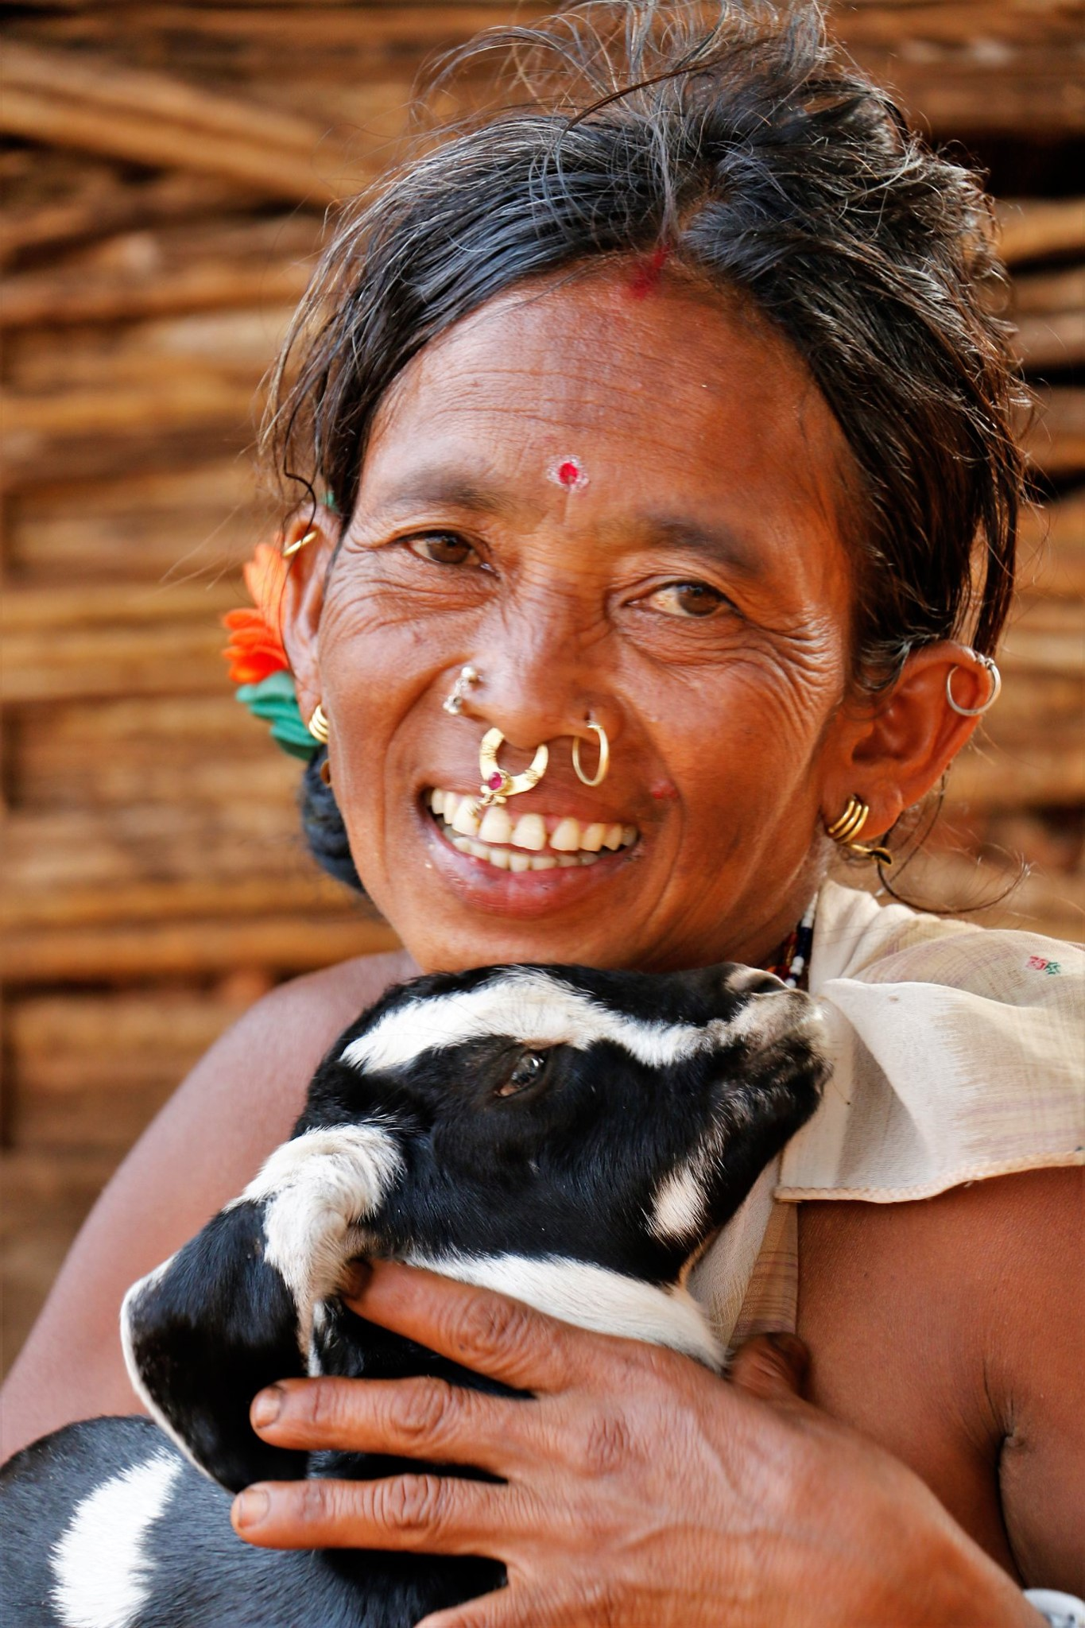
Process of Determination and Recognition of Habitat Rights

Slide 13
Process of Habitat Rights Determination
Initiation of the habitat rights claims process
Consultation with Traditional Leaders and FRC members & Determination of habitat rights
Training programmes for all traditional leaders, Gram Sabha presidents, and Forest Rights Committee (FRC)
Claim Making Process at clan level
Claim Verification by FRCs
Organize Gram Sabhas in all identified settlements of the PVTG & Filing of Claims & Submission of Claims

Slide 14
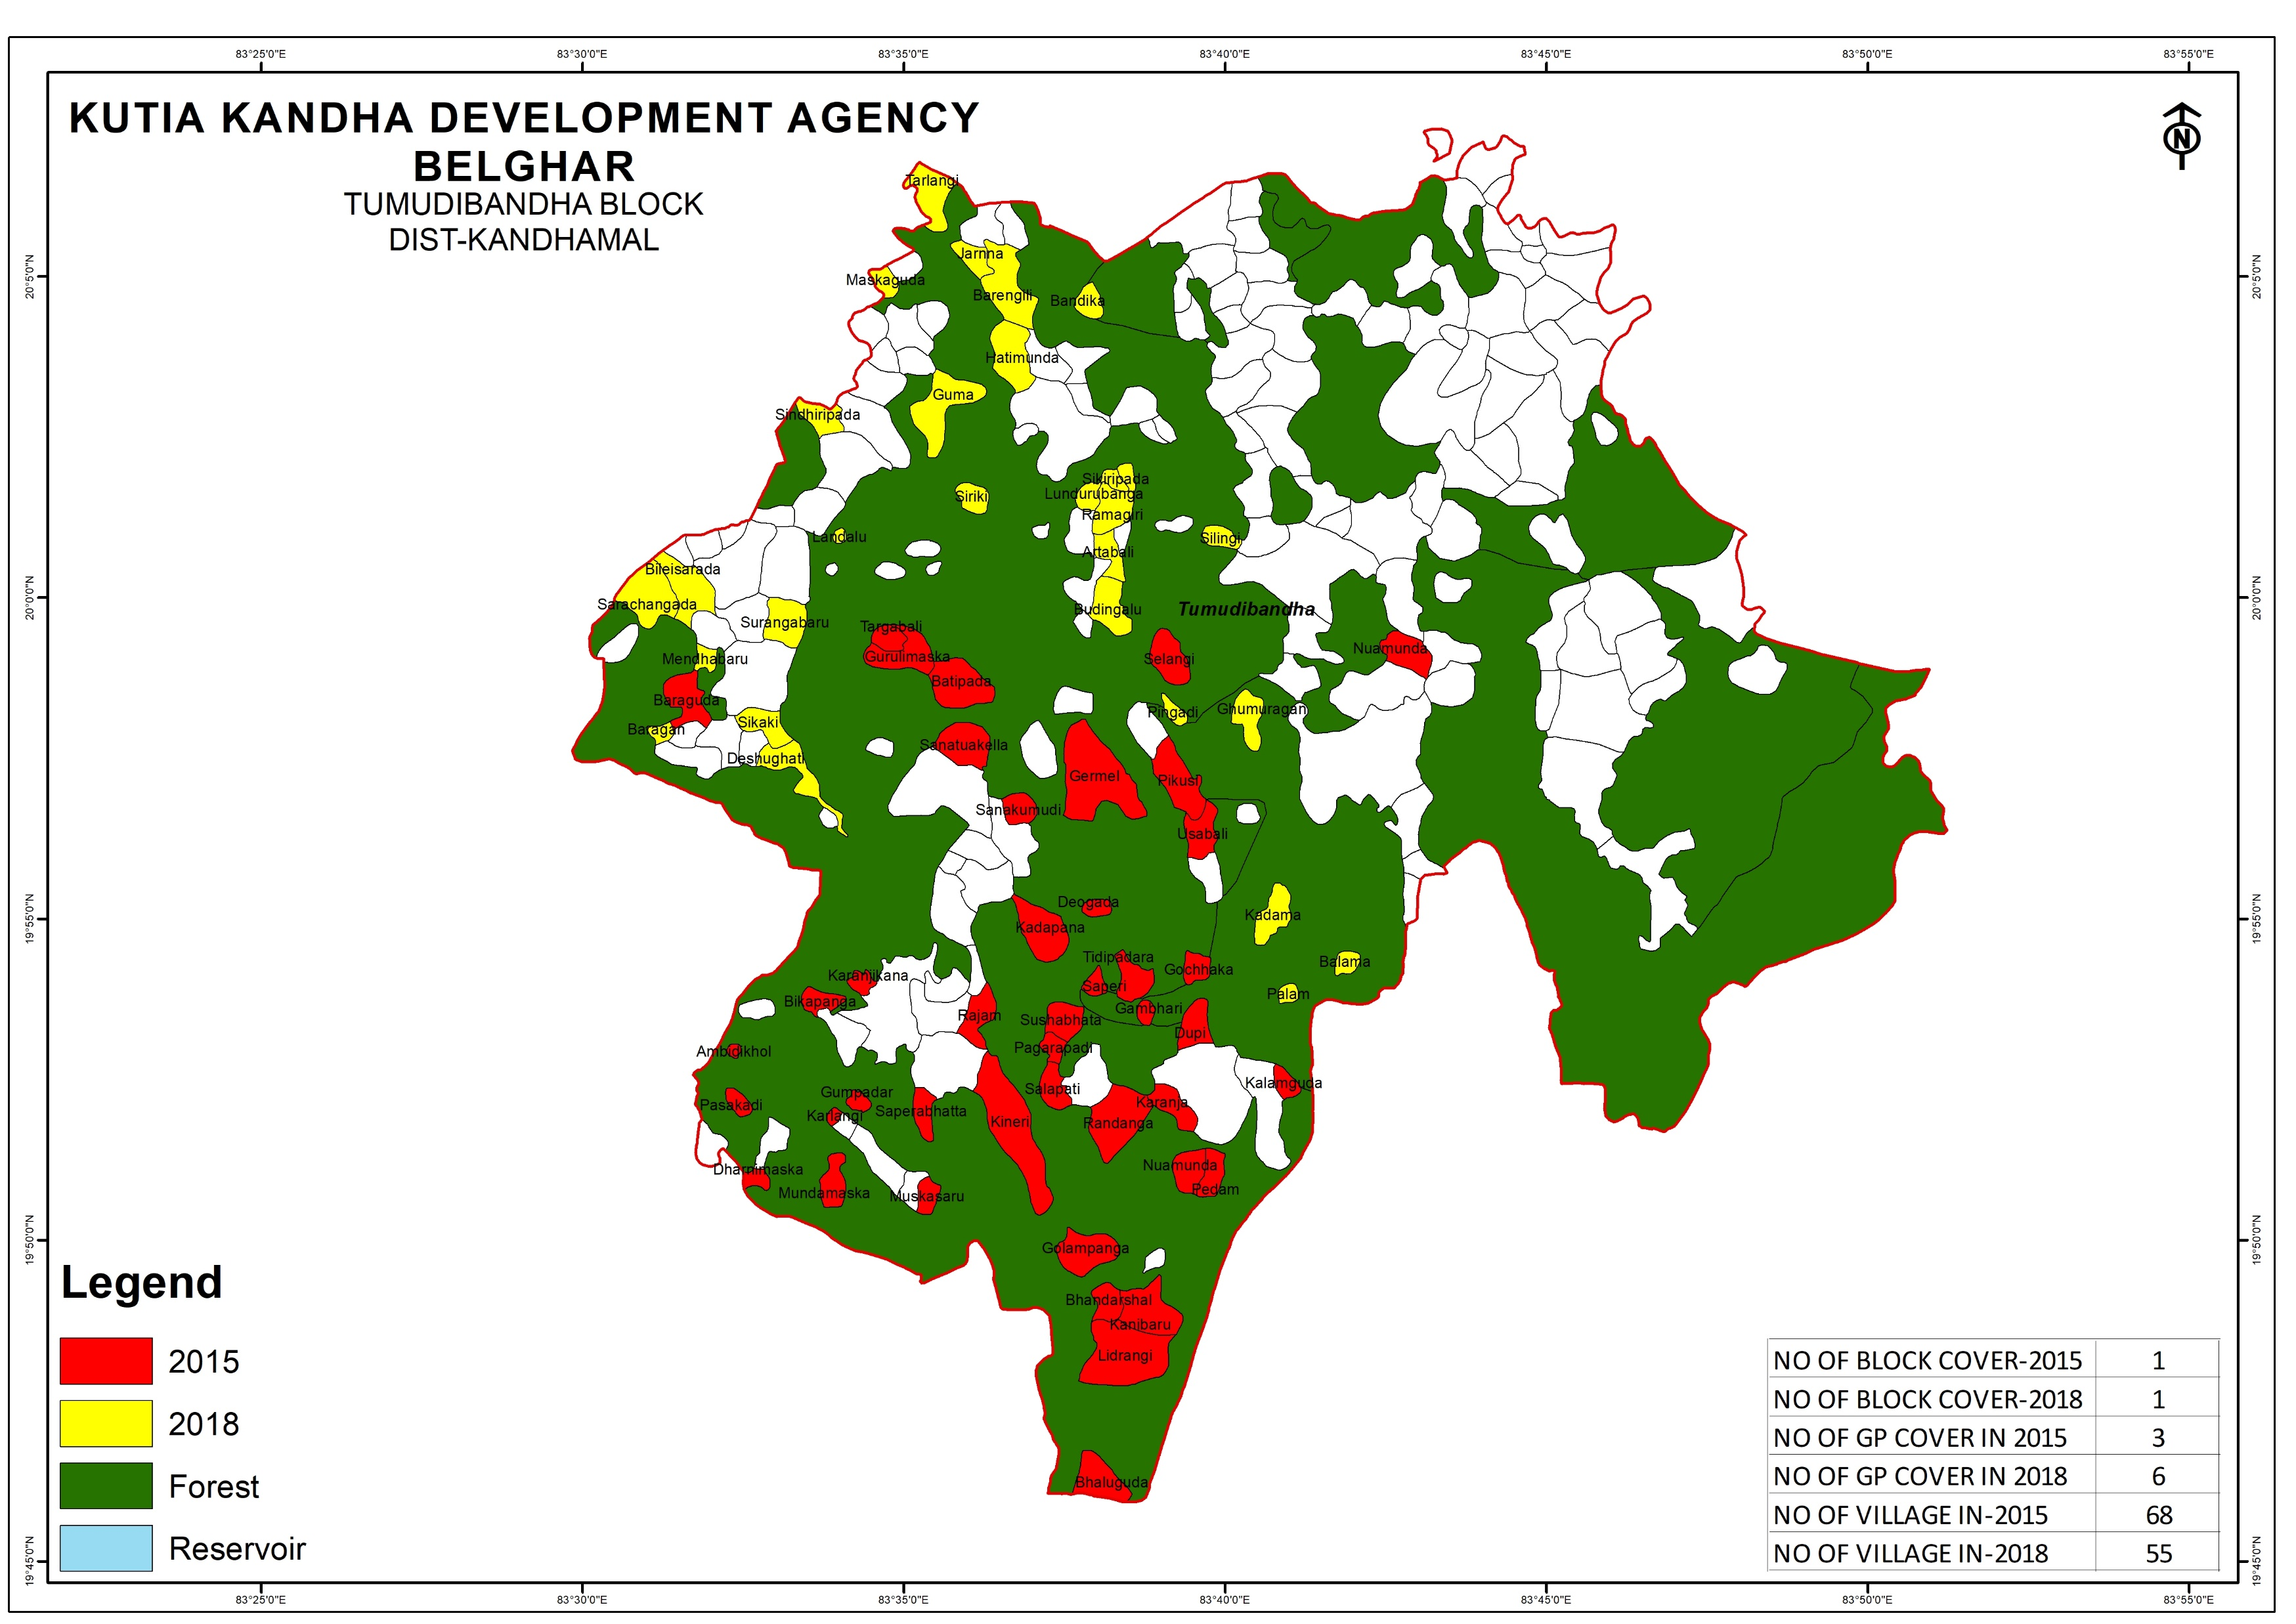
Recognition of Habitat Rights
The concerned DLC will verify the claims.
prepare a final digitized geo-referenced map of the area recognized
DLC meeting minutes shared

Slide 15
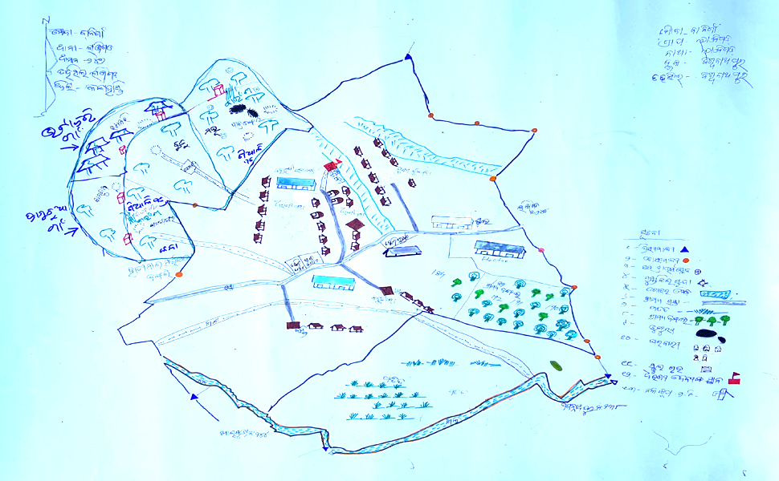
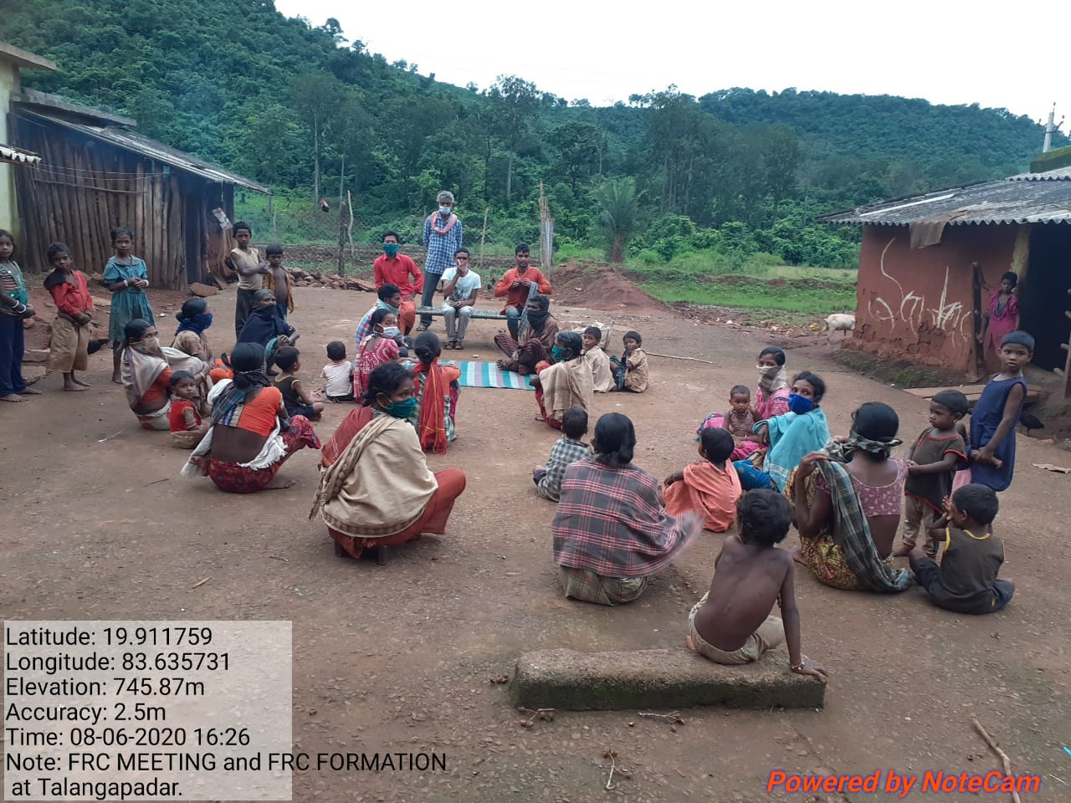
Status of Habitat Rights in Kandhamal
Kutia Kondh:
Sensitization to the community leaders and frontline officers has been done by SCSTRTI and VASUNDHARA at KKDA, Belghar
Gram Sabhas have been done at village level
Maps of the Habitat has been prepared
Claims have been submitted at SDLC

Slide 16
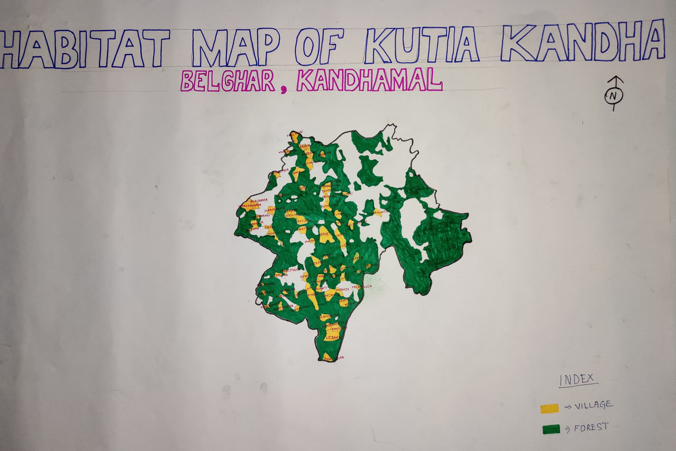

Slide 17
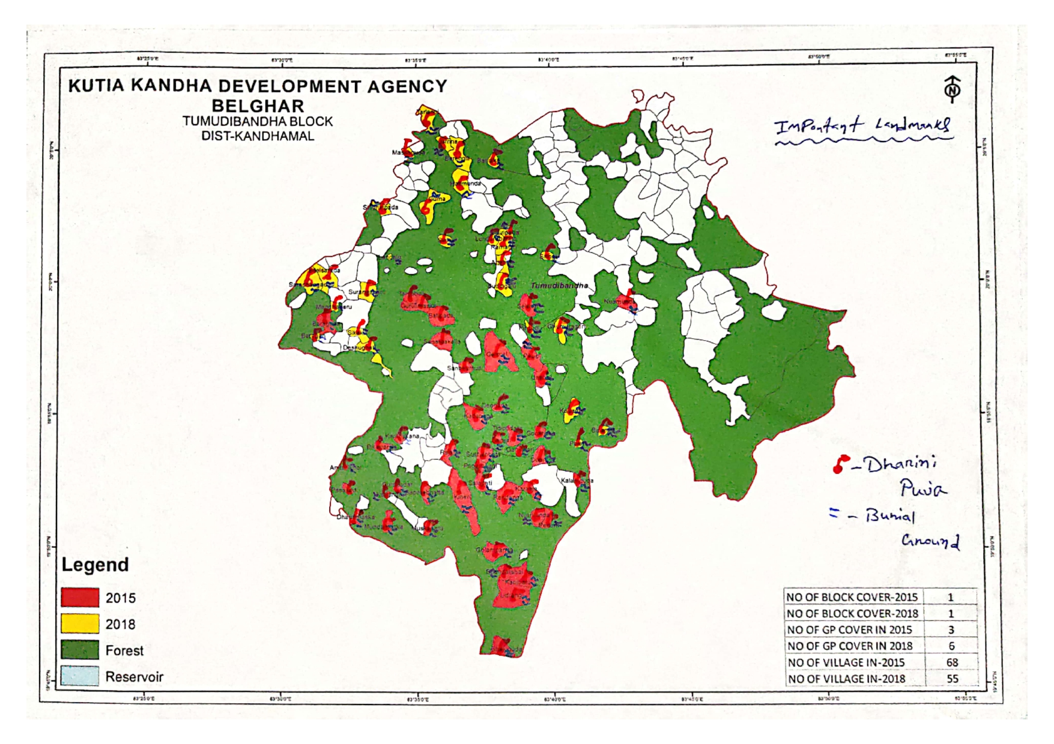

Slide 18
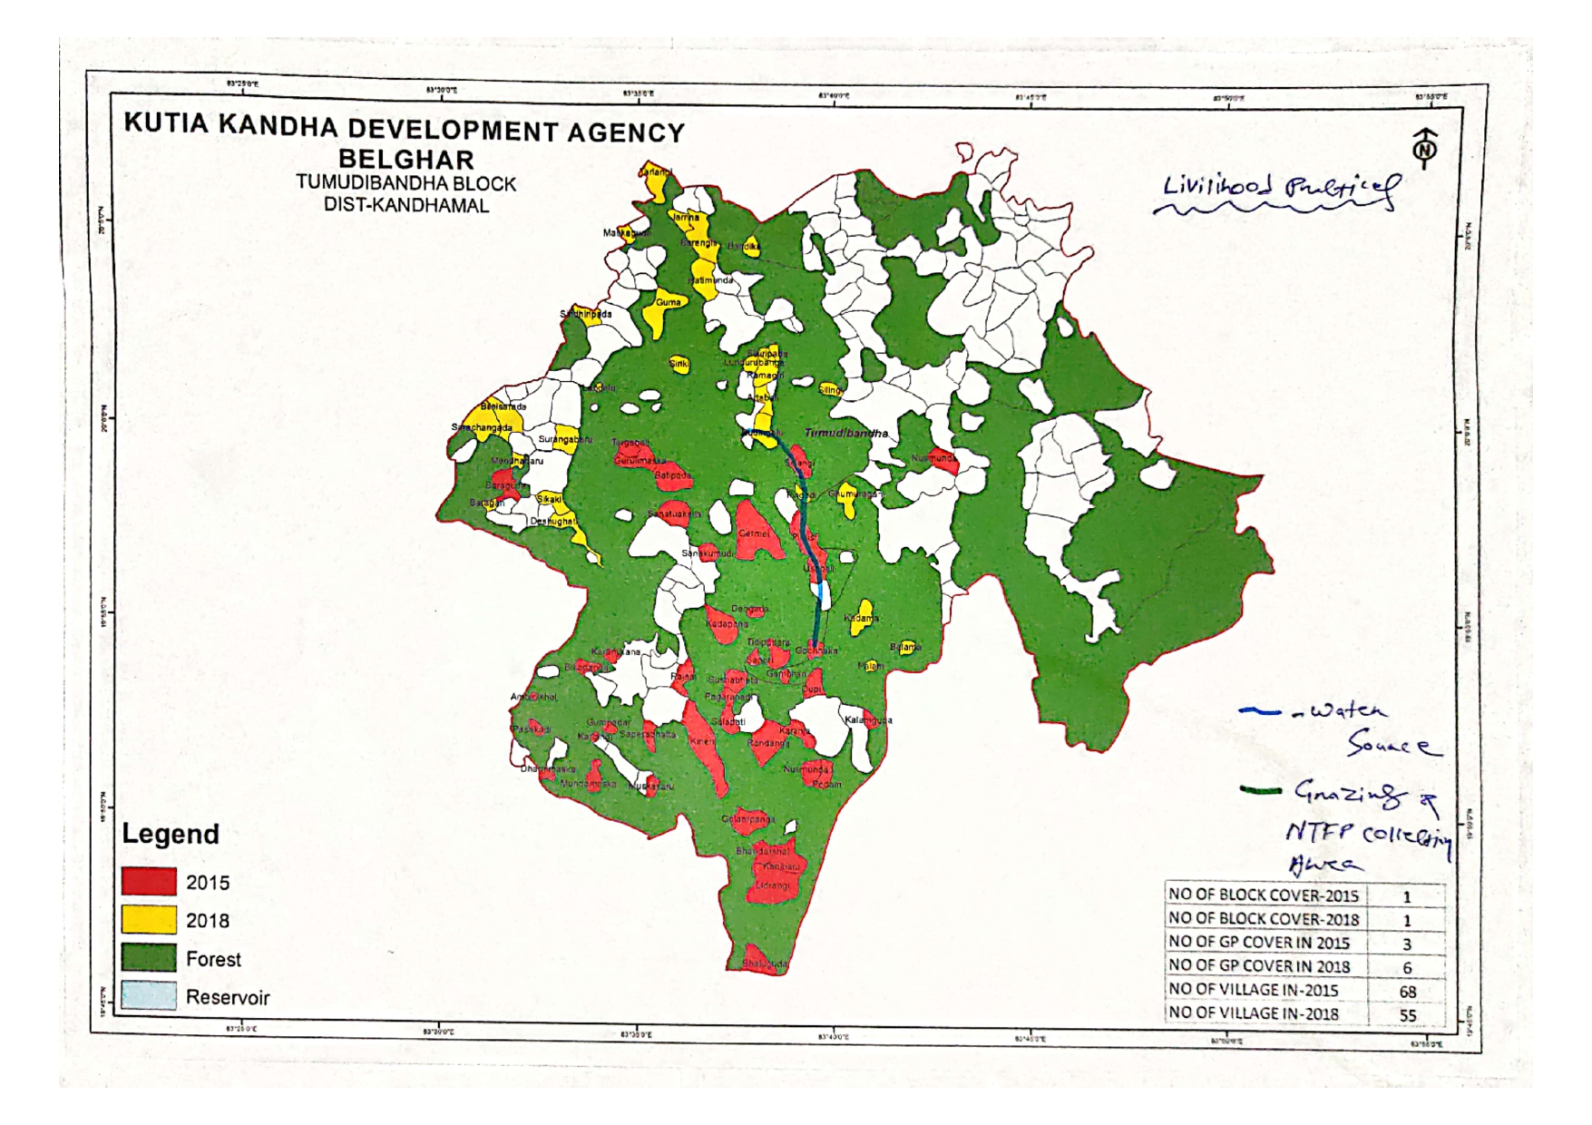

Slide 19
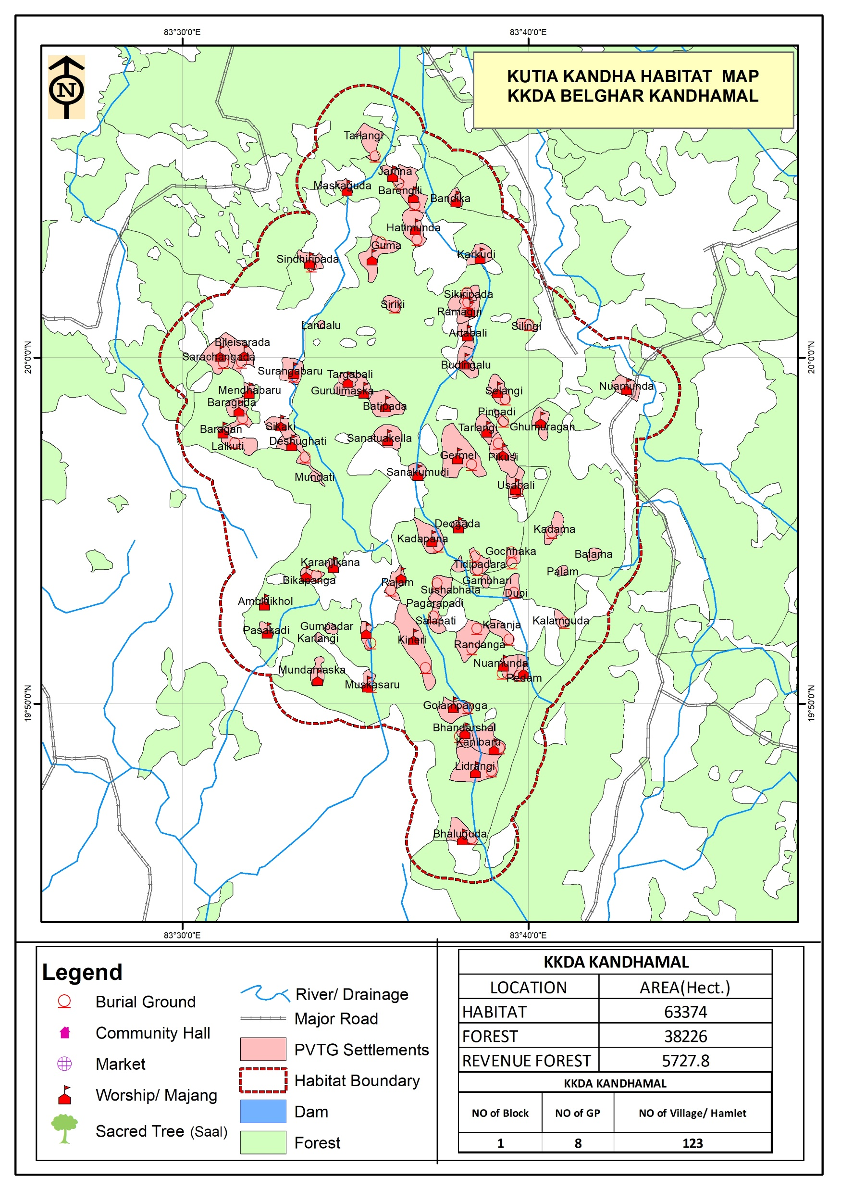
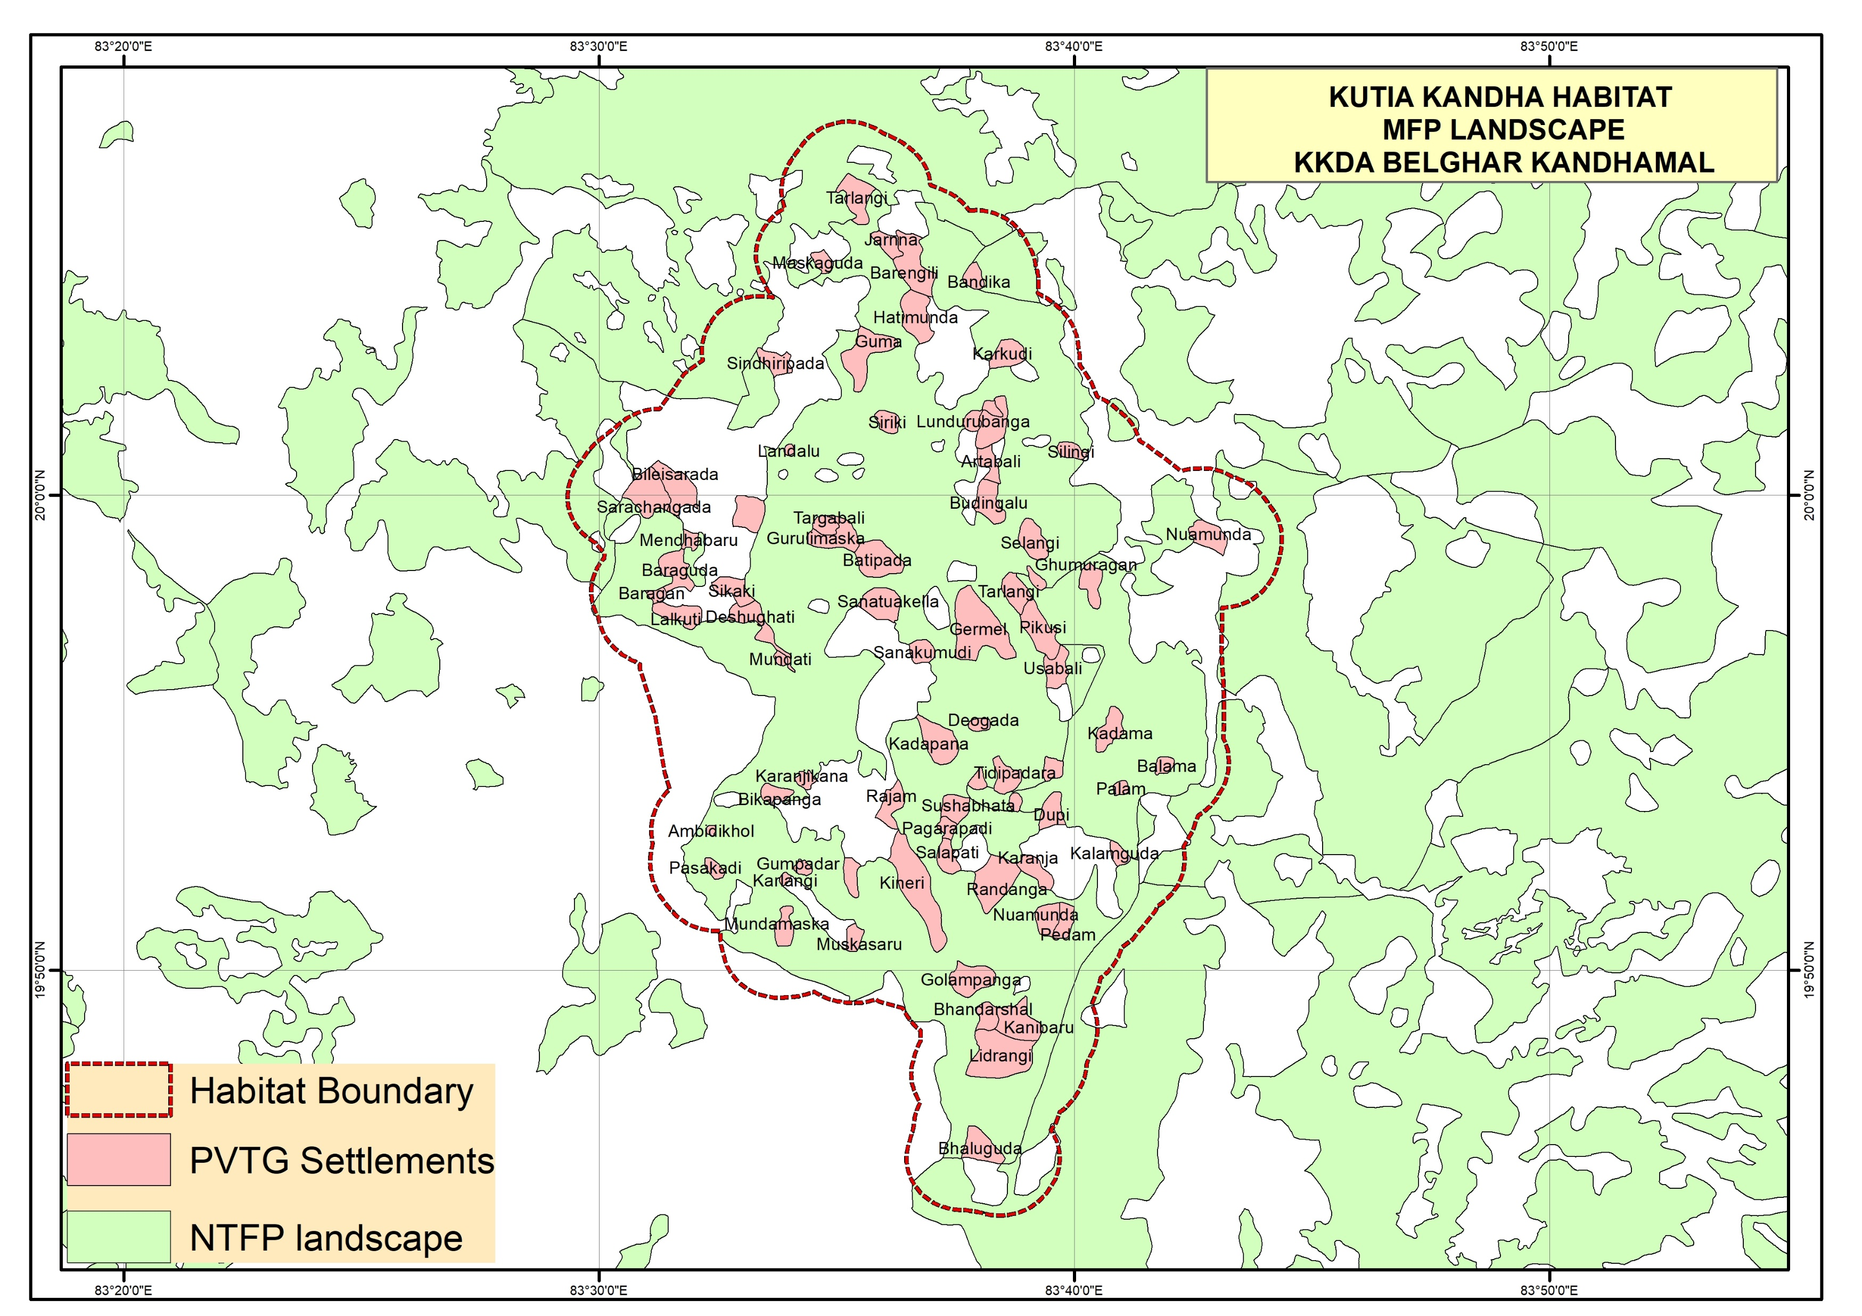

Slide 20
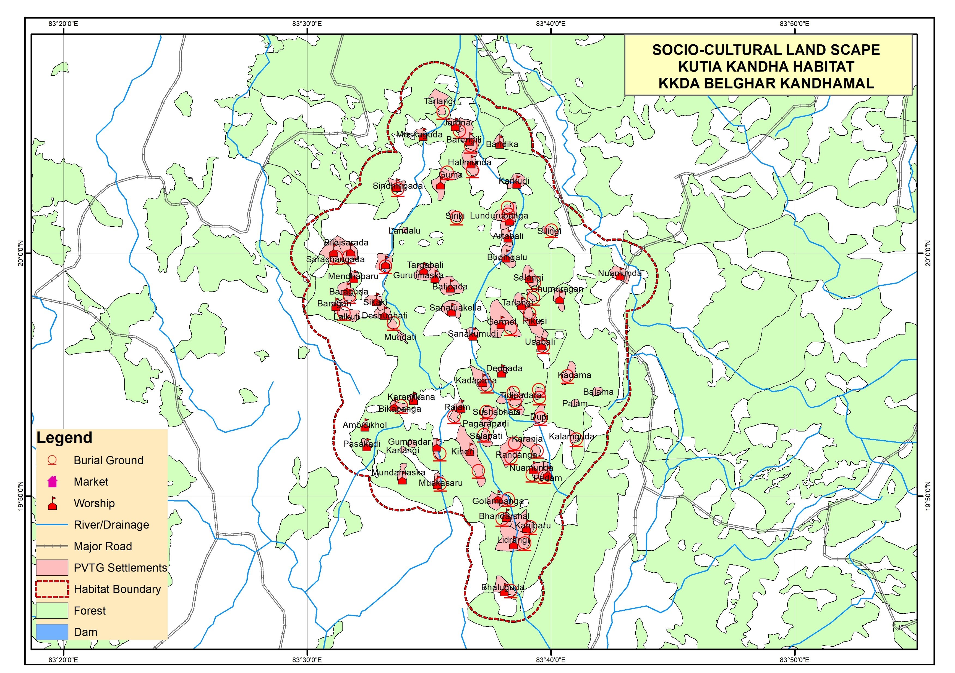

Slide 21
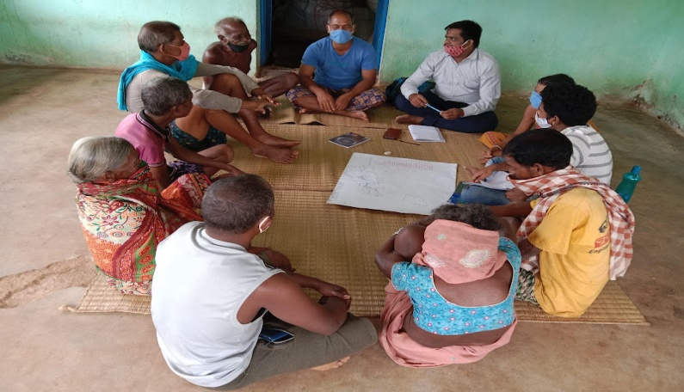
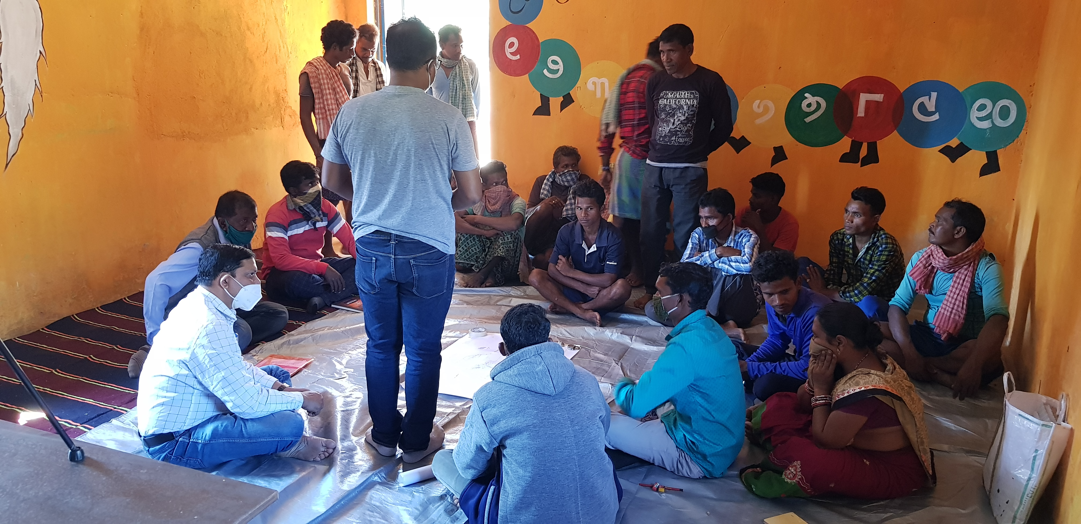
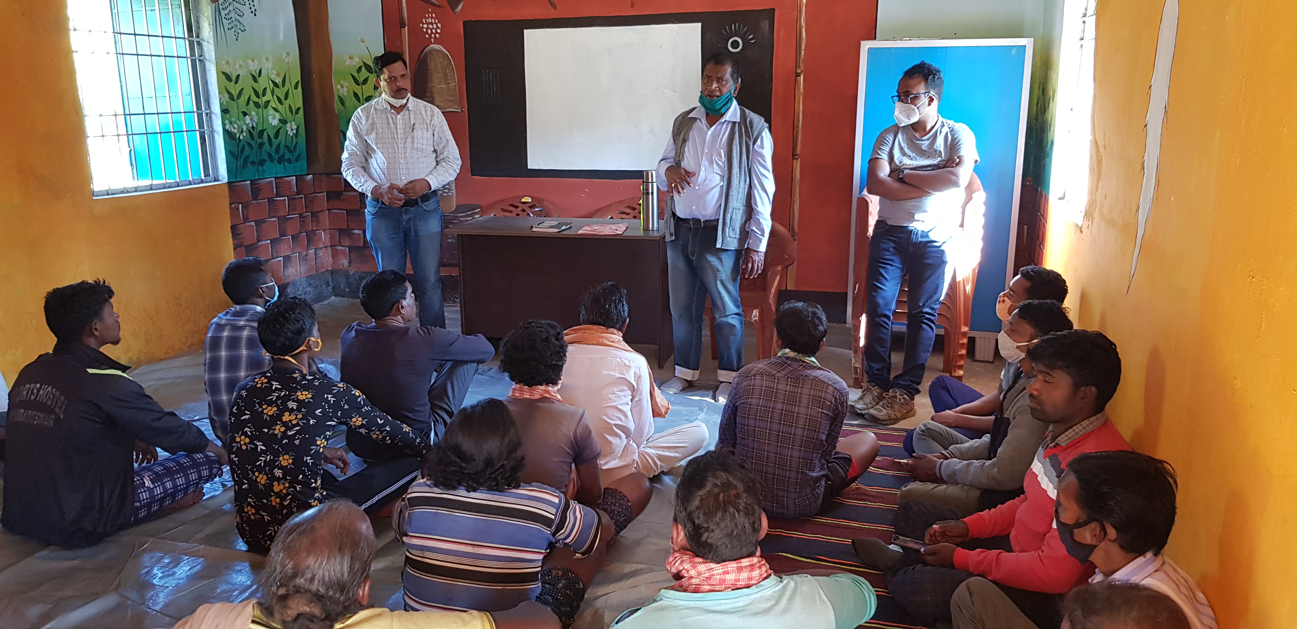
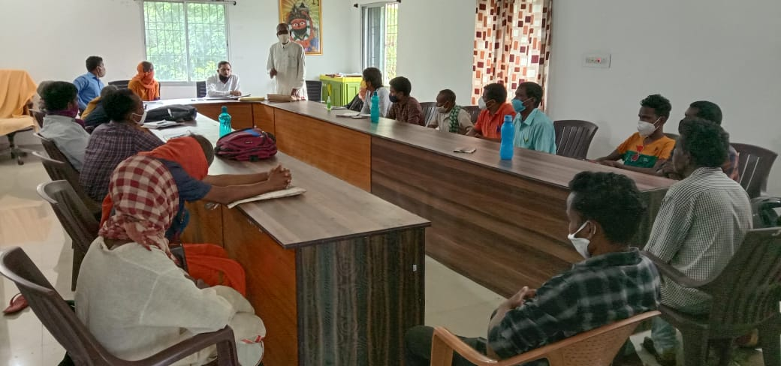
Photos

Slide 22
