Slide 1
Conversion of Forest village to Revenue village
Forest Right Act- 2006, U/S-3(1)(h)

Slide 2
Forest village Rights and definition
Forest Right Act 2006 -U/S-3(1)(h)
Rights of settlement and conversion of all forest villages, old habitation, unsurveyed villages and other villages in forests, whether recorded, notified or not into revenue villages;
''forest villages'' means the settlements which have been established inside the forests by the forest department of any State Government for forestry operations or which were converted into forest villages through the forest reservation process and includes forest settlement villages, fixed demand holdings, all types of taungya settlements, by whatever name called, for such villages and includes lands for cultivation and other uses permitted by the Government;

Slide 3
Basic Difference in between the Revenue Villages and Forest Villages
Revenue Village | Forest Village | Old habitation/ Un-surveyed Villages
Defined borders Interlinked with post office and police station People living within a village enjoy all the benefit of various schemes and developmental programs Government records mentions details of the village Inhabitants pays cess on their holdings | No Borders/ Defined in certain States Hardly interlinked with Post office and Police Station Under administrative control of FD Certain States such habitations are linked with nearest Revenue village Ownership of land rests with FD Deprived from all the Government Programs and Schemes Programs and schemes are channelized through FD | No Borders Hardly interlinked with Post office and Police Station Certain States such habitations are linked with nearest Revenue village Deprived from all the Government Programs and Schemes Inhabitants leads a life of refugee No Pattas Threat of Eviction is high No Compensation if land is acquired for any developmental activities

Slide 4

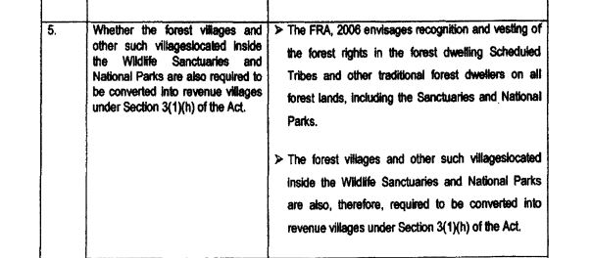
ISSUES
CLARIFICATION

Slide 5
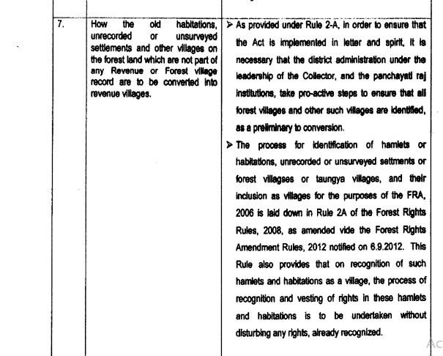
ISSUES
CLARIFICATION

Slide 6
Steps of conversion
Collector’s proclamation Letter/notice for conversion
(ଜିଲ୍ଲାପାଳଙ୍କ ବିଜ୍ଞପ୍ତି)
Tahasildar / WEO forwards the letter/notice to the GP & Sarpanch and forest village
(copy also send to concerned RI,DFO)
Conversion notices are displayed at the GP office, Public places of GP and forest villages as well.

Slide 7
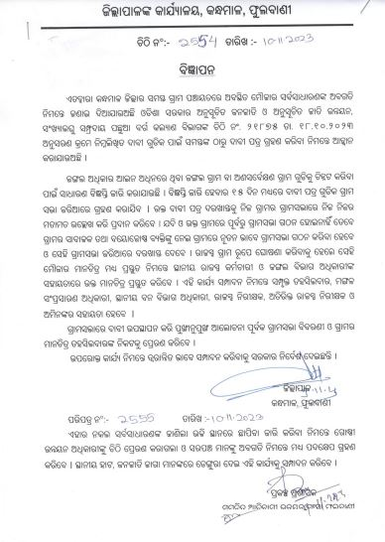

Slide 8
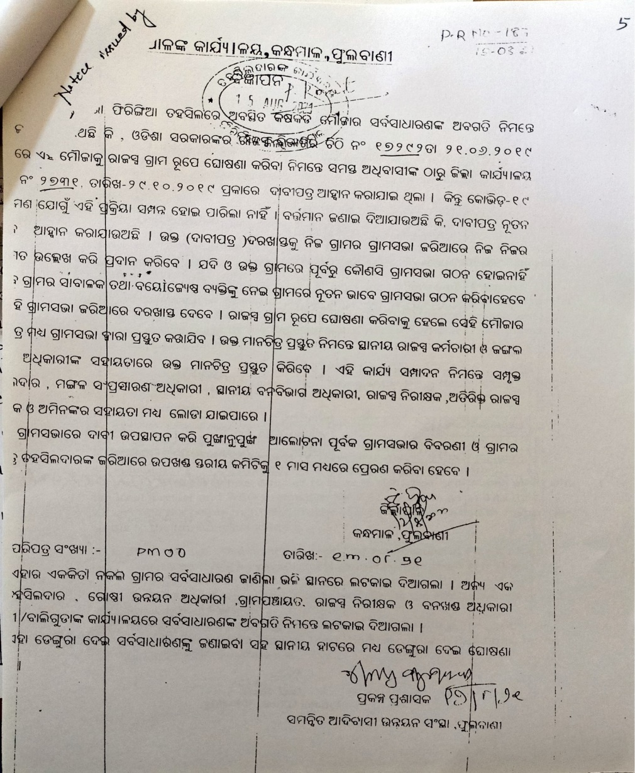
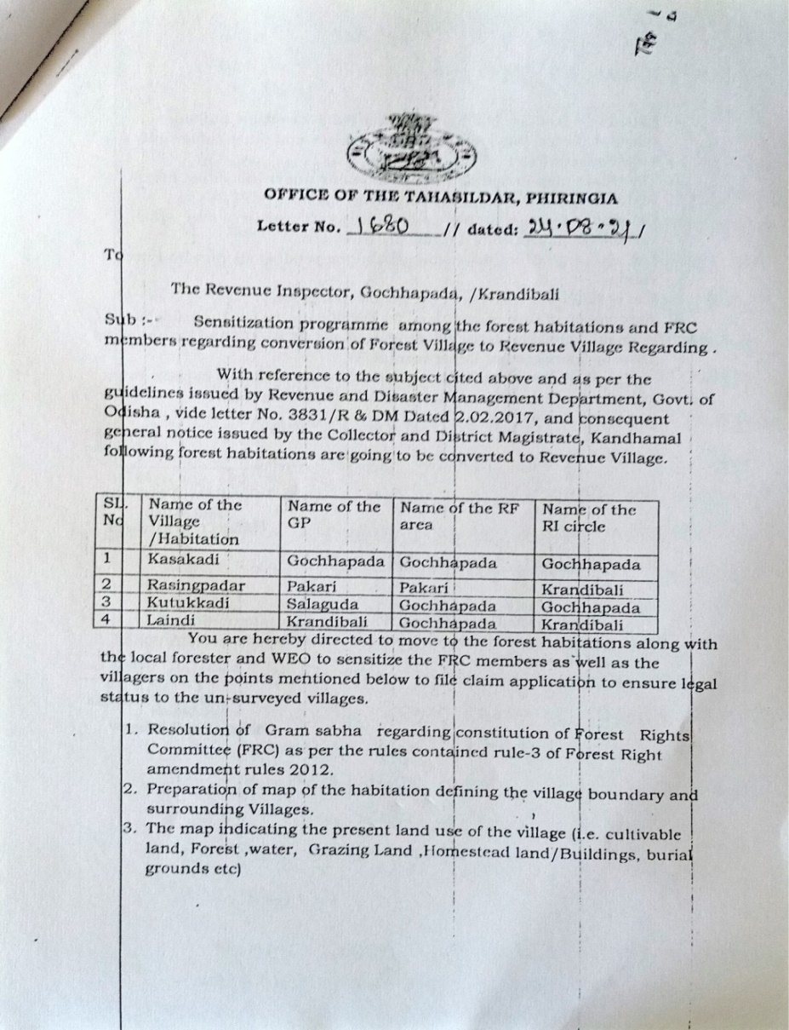
NOTICE FROM COLLECTOR & TAHASILDAR

Slide 9
Source of obtaining information / Identification Process relating to Forest Villages/ Un-surveyed Villages / Old Habitation /Settlement
Identification through Gram Panchayat: Gram Panchayat to prepare a list of forest villages, un-surveyed villages, old habitations or settlements within the forestland
Identification through Government Records: All villages/settlements on forest land should be identified with the help of District Statistical Handbooks and Census Village Directories. All settlements with zero revenue land should be presumed to be forest villages in order to be converted into revenue villages under the Act.
Obtaining List from Forest Department: List of forest villages can be obtained from Divisional Forest Office.
Obtaining List from Revenue Department: Villages re-habilited in the forestland, those displaced from developmental projects.
Call for Public Suggestions: Public suggestions and inputs should be invited through a public notice in all panchayat offices, forest offices and market places informing the public of this right and requesting villages on forest land to submit claims or to contact the concerned officials for assistance.

Slide 10
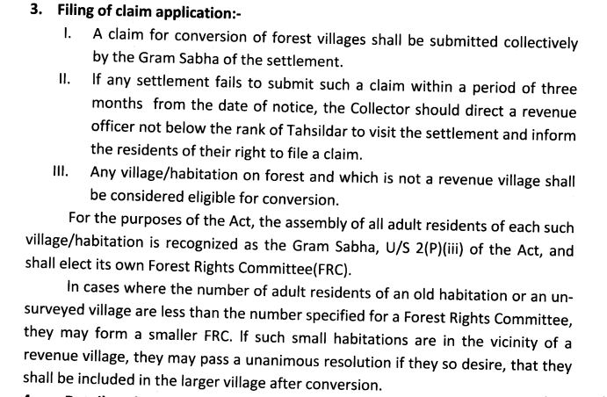
As per the guideline
R&DM Letter no:2015-3831 Dated 2/2/2017

Slide 11
Steps Continued…
ଜଂଗଲ ଗ୍ରାମ ରେ ସଚେତନତା ବୈଠକ’
ସହମତି ପତ୍ର ଗୁଡିକ ତାହାସିଲଦାର ଜରିଆରେ ଜିଲ୍ଲାପାଳଙ୍କୁ ପ୍ରେରଣ
ଜଂଗଲ ଗ୍ରାମ ରେ ଜଂଗଲ ଅଧିକାର କମିଟି ଗଠନ

Slide 12
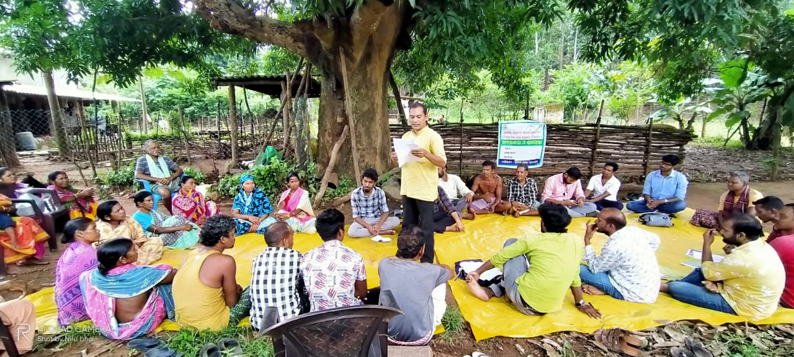
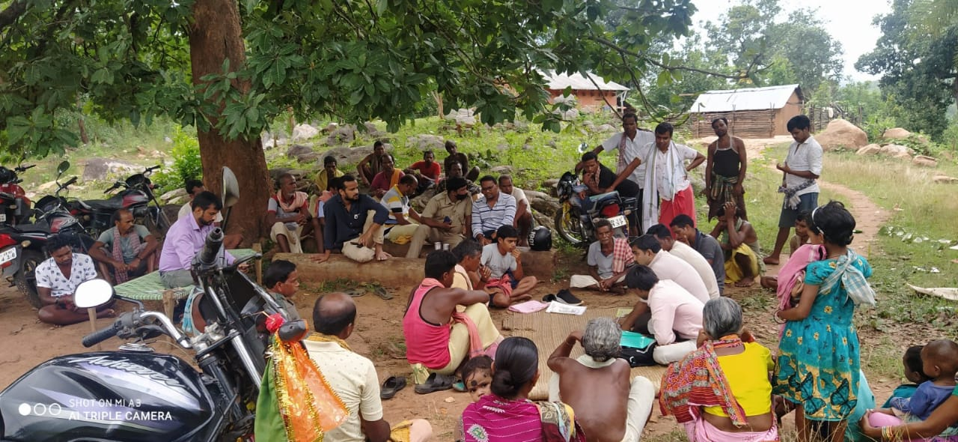
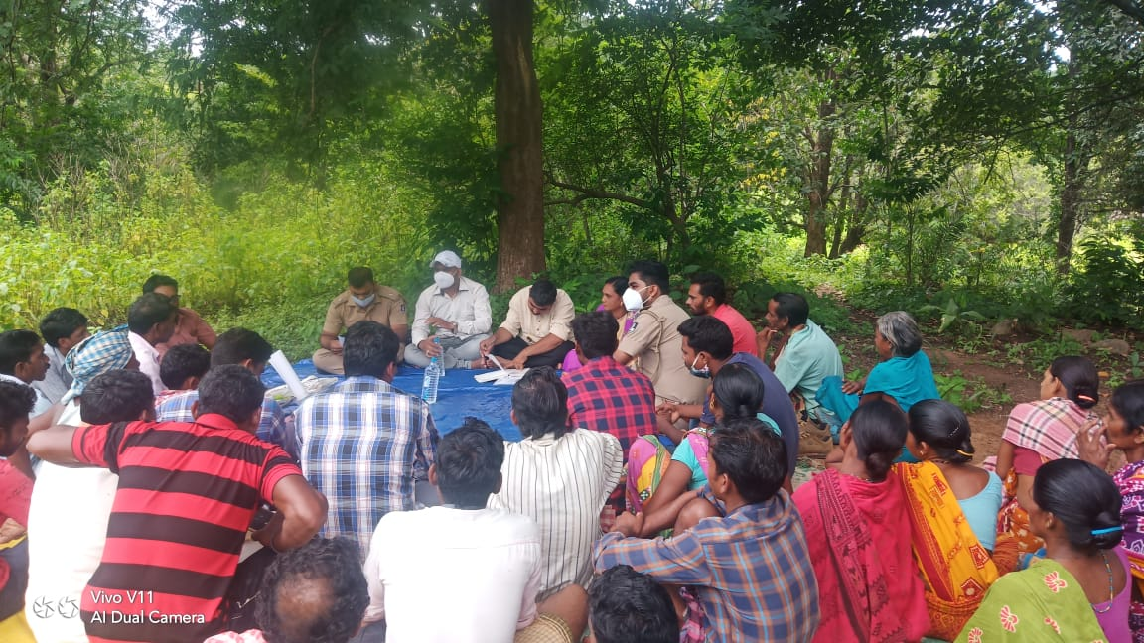
FOREST VILLAGE LEVEL AWARENESS
In presence of
Forest department
Revenue department (RI)
WEO
Sarpanch (PRI member)
village community

Slide 13
Steps Continued……
Step-7
ଗ୍ରାମ ଗୁଡିକରେ ସମାଜିକ ଏବଂ ସମ୍ବଳ ମାନଚିତ୍ର ପ୍ରସ୍ତୁତି
ଗ୍ରାମର ପରିବାର ଅନୁଯାୟୀ ଜନସଂଖ୍ୟା ବିବରଣୀ (ଯଦି ଆଧାର/ଭୋଟର କାର୍ଡ଼ ଥାଏ, ତେବେ ସଂଲଗ୍ନ କରାଯିବ)
Step-8
ସମ୍ବଳ ମାନଚିତ୍ର ଅନୁସାରେ ଗ୍ରାମର ସୀମା ନିର୍ଧାରଣ ( ହାତ ନକ୍ଶା ପ୍ରସ୍ତୁତି)
ଯଦି ଗ୍ରାମ କୁ ଲାଗି ପଡୋସୀ ଗ୍ରାମ ଥାଏ ତେବେ ପଡୋସୀ ଗ୍ରାମ ମାନଂକ ସହ ଯୁଗ୍ମ ବୈଠକ
Step-9
GPS ସହାୟତା ରେ ଗ୍ରାମର ସୀମା ନିର୍ଧାରଣ ଓ ମାନଚିତ୍ର ପ୍ରସ୍ତୁତି (ବାଧ୍ୟତାମୁଳକ ନୁହେଁ)
ଗ୍ରାମର ମାନଚିତ୍ର ଅସିଲା ପରେ ଗ୍ରାମର ଚୌହଦୀ ଓ ସୀମା ର ସତ୍ୟାସତ୍ୟ ନିରୁପଣ
ବ୍ୟକ୍ତିଗତ ଉପଯୋଗ ପାଇଁ ବ୍ୟବହୃତ (ଚାଷ ଓ ବାସ) ଗୁଡିକର ଆକଳନ

Slide 14
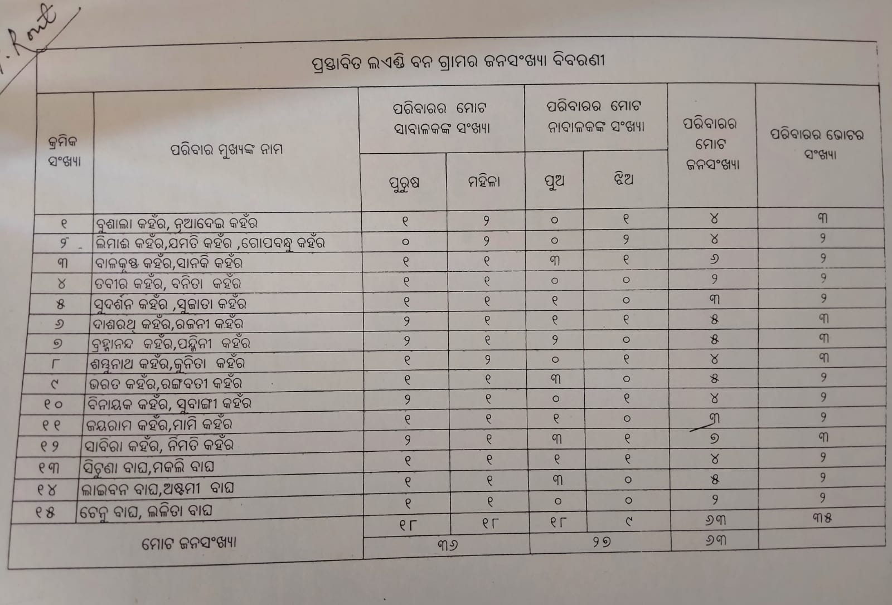
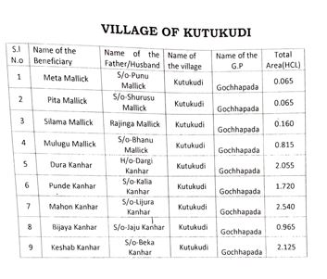

Slide 15
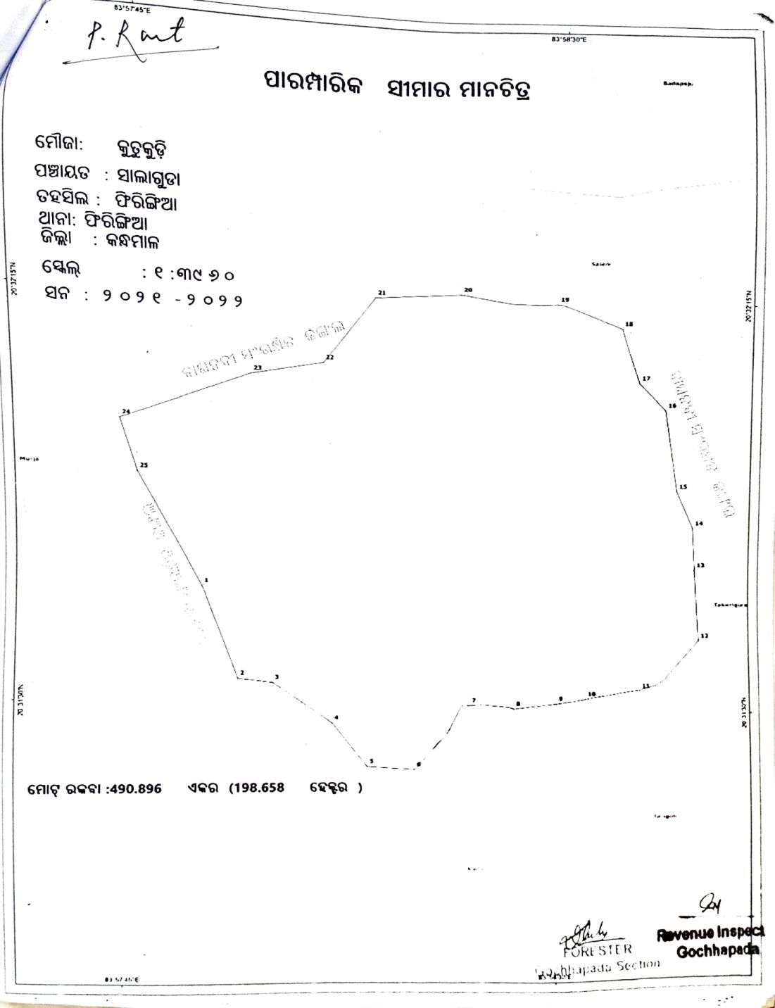
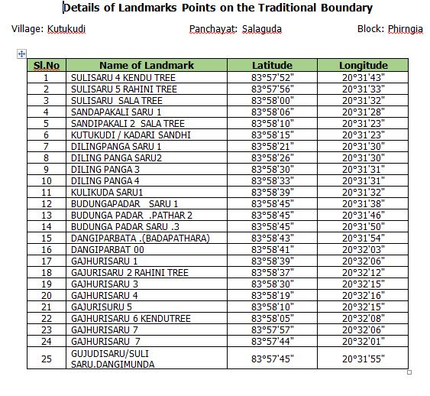
Boundary of forest village and coordinate

Slide 16
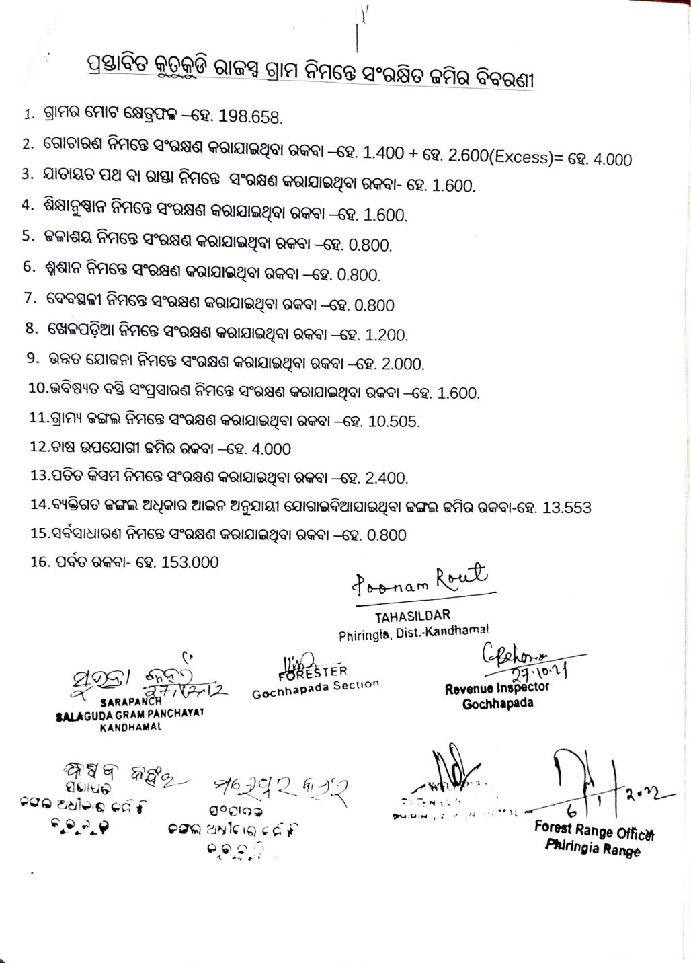
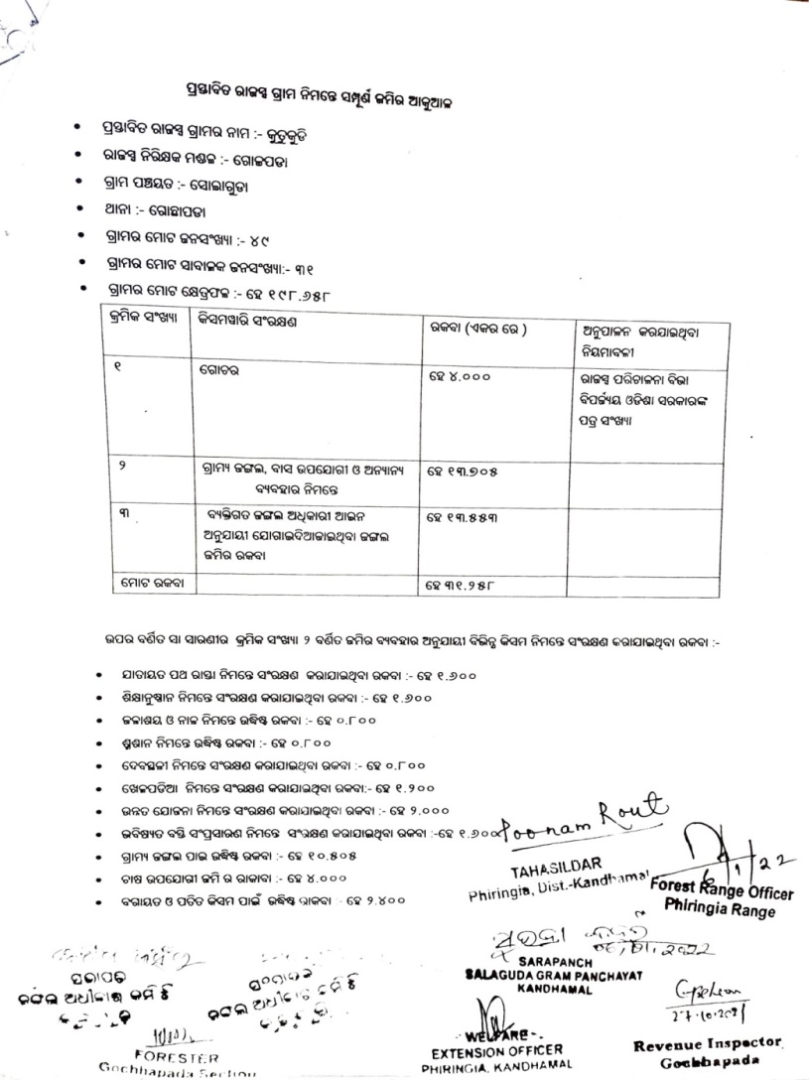

Slide 17
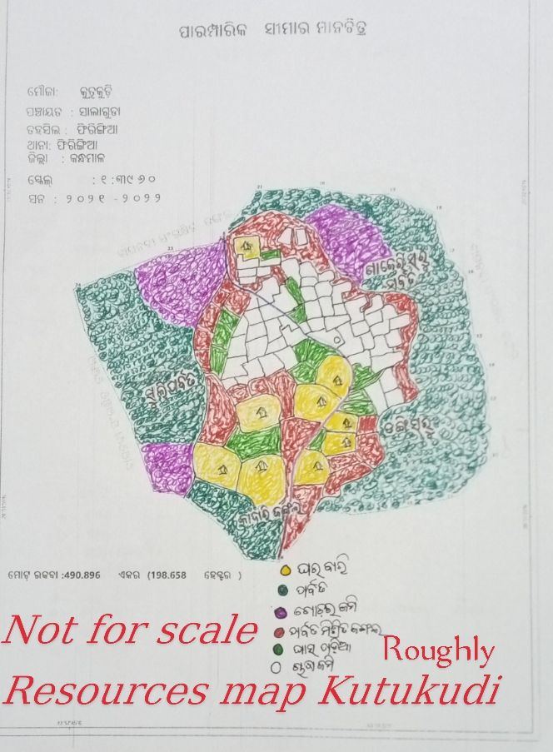

Slide 18
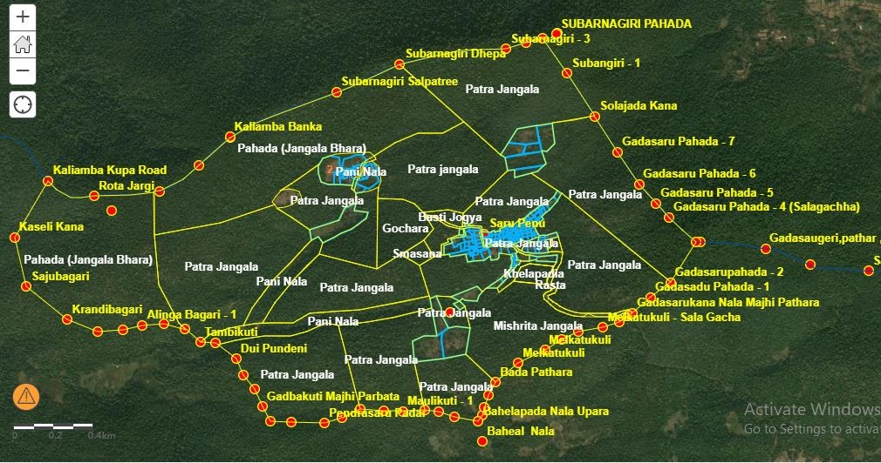

Slide 19
Steps Continued….
Step-11
ପ୍ରସ୍ତାବିତ ଗ୍ରାମ କୁ ରାଜସ୍ବ ଗ୍ରାମ ରେ ପରିବର୍ତନ କରିବା ନିମନ୍ତେ ସଂରକ୍ଷଣ ଜମିର ଆକଳନ (Reservation posting)
Step-12
ବର୍ତମାନ ଅଧିକରଣ ରେ ଥିବା ଜମି ର ଚିନ୍ହତୀ କରଣ
ଗ୍ରାମ ରେ ପଲ୍ଲିସଭା ଆୟୋଜନ ଏବଂ ସମସ୍ତ ଦାବି ଦସ୍ତାବିଜ୍ ର ଅବଲୋକନ
Step-13
ଗ୍ରାମରେ ଚୁଡାନ୍ତ ଗ୍ରାମସଭା ଆୟୋଜନ
ତାହାସିଲଦାର ଜରିଆରେ ଗ୍ରାମର ଦାବି କୁ ଉପଖଣ୍ଡ ସ୍ତରୀୟ କମିଟି କୁ ପ୍ରେରଣ
ପୁର୍ବରୁ ମିଳିଥିବା ଜଂଗଲ ଜମି ଓ ବ୍ୟକ୍ତିଗତ ଜମି ଚିନ୍ହତୀ କରଣ (ଯଦି କିଛି ଥାଏ)
ଅଧିକରଣ ଜମି ଗୁଡିକର ସତ୍ୟାସତ୍ୟ ନିରୁପଣ

Slide 20
Process Guideline issued by MoTA (2013)
Identification & Compilation of Information through the Secondary Reports and Public Notice
Consolidation of collected information by SDLC
Constitution of FRCs
Inviting claims through Posting of Notices in all identified villages/habitations
If claims are not submitted within 3 months after posting of Notices, Tehsildar would visit the settlement & inform them about their right and filling procedure
Determination of nature & extent of Forest Rights (IFR, CR, CFR) by GS along with future requirement
Adoption of Resolution for conversion of Forest Village into Revenue Village & Forward to SDLC
Examination by SDLC and forward to DLC
Process of Conversion shall be started within 2 weeks of DLC Decision

Slide 21
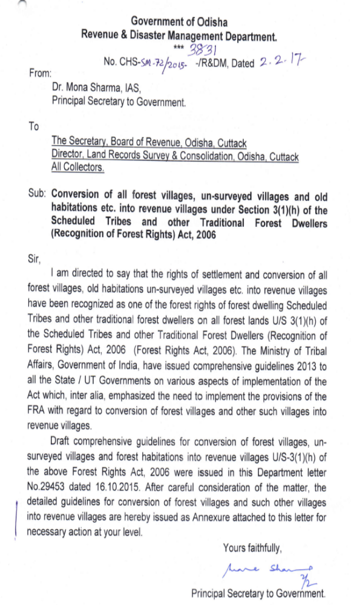
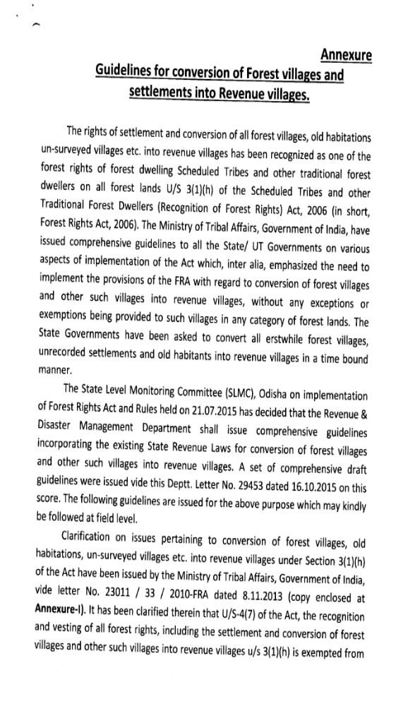
Guideline by R&DM Department

Slide 22
Key Highlights of Guideline
Role of Revenue and Forest Department:
  Revenue Inspector shall extend support to the Gram Sabha for conversion of forest villages into revenue village in collaboration with the local forest officer;
  If, the village or habitation or settlement is located inside the forest land, which is under the management of the State Forest Department, then, the concern forest department shall provide map of the area for the purpose demarcation of the land;
  The forest officer shall be present at the time of consultation and preparation of map of the village;
General Clarifications:
  Doesn’t require approval under the Forest (Conservation) Act, 1980;
  Every village or habitation or settlement converted under the Forest Rights Act, 2006 need to be recorded as ‘Village’ in revenue record;
  The legal status of land of the village shall remain as ‘Forest Land’;
  The classification of land shall be as per the State Revenue Laws

Slide 23
Key Highlights of Guideline
Compliance with State Revenue law:
  the District Collector shall follow the process as required under sub-Section 14 of Section 2 of Orissa Survey and Settlement Act, 1958;
  forward the proposal to the Board of Revenue with case record containing details like the map of the village, list of inhabitants, list of claimants under the Forest Rights Act, 2006, resolution of Gram Sabha, SDLC and the proceedings of the DLC, in which the proposal is approved along with Thana No. of the proposed revenue village for declaring it as revenue village;
  the Board of Revenue shall send a copy of such notification [U/s 2(14) of the Orissa Survey and Settlement Act, 1958] to Government with recommendation for notifying the village as “Revenue Village” U/s 3(1) of the Orissa Survey and Settlement Act, 1958 or the Odisha Special Survey and Settlement Act, 2012;
  After approval of the Government, the Board of Revenue would declare it as “Revenue Village” under the relevant provisions of either the Orissa Survey and Settlement Act, 1958 or the Odisha Special Survey and Settlement Act, 2012 and the process of settlement of rights of the residents of the new village shall be carried out with their corresponding Rules.

Slide 24
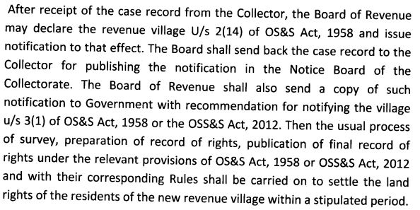
As per the guideline
R&DM Letter no:2015-3831 Dated 2/2/2017

Slide 25
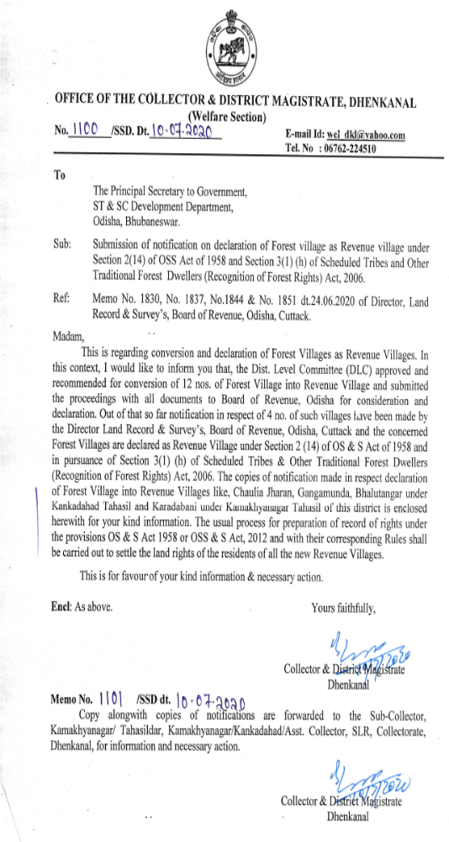
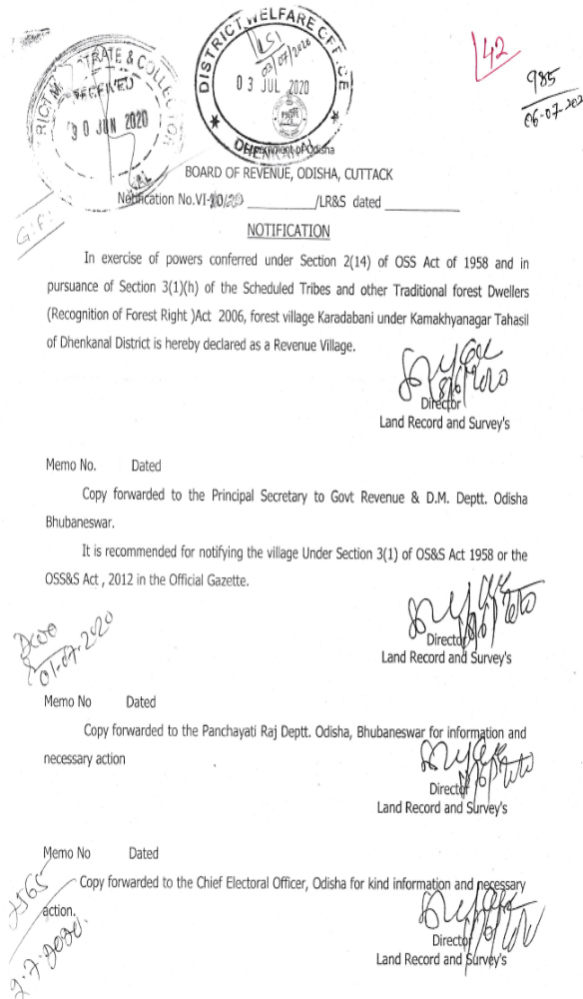
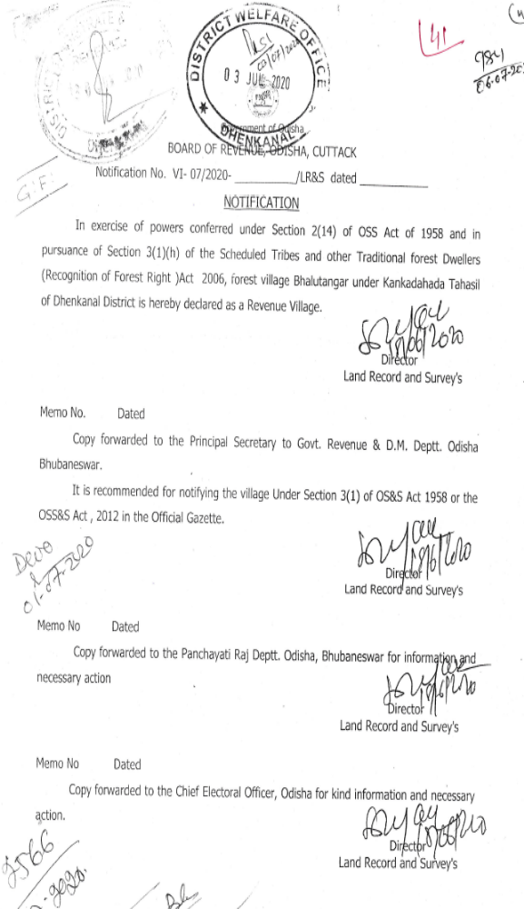
Notification of Board of Revenue

Slide 26

Thank You

